Slide 1
Today’s Special: eForms Your Way with a Side of AWE
Notes:
Welcome Everyone!!
Thank you for joining the HEUG E-Academy Program. The topic of this webinar, ‘Today’s Special: eForms Your Way with a Side of AWE’ will cover the exciting topic of Gideon Taylor eForms, a bolt-on eForm application that utilizes Peoplesoft Approval Workflow Engine, also known as AWE. This topic is near and dear to my heart and I am excited to share this with you today.

Slide 2
Introductions
Andrea Lloyd
Senior Business Systems Analyst
University of California, Berkeley
Scott Antin
Vice President, Business Development
Gideon Taylor
Notes:
I would like to introduce today’s presenters, Scott Antin is here with us today. Scott is the Vice President Business of Development at Gideon Taylor. Scott, would you like to introduce yourself.
Thank you Scott!
My name is Andrea Lloyd, I am a Senior Business Systems Analyst at University of California Berkeley in the Berkeley IT – Campus Applications and Data Team. I have been with Berkeley for 7 years and in Non-Profit Higher Education for 14 years.
Prior to my time at Berkeley I started my Higher Education career in IT at California State University Channel Islands which is also my Alma Mater.
I earned a Bachelor in Biology with a Minor in Chemistry, not quite where I ended up but it definitely prepared my analytical side.
I have experience is in various Oracle applications including: Campus Solutions, HCM and SF. In Campus Solutions specifically I have worked within Student Records, Financial Aid, Advising, Campus Community and the Transfer Credit modules and most of my experience at Berkeley has been leading the eForm & Workflow efforts building Gideon Taylor eForms & AWE process solutions.

Slide 3
Cal
University of Berkeley, California
Located in the Bay Area
15 miles from San Francisco
Founded in 1868
Our House
#2 Public University – U.S. News & World Report
135,021 Undergraduate Applications, 2021 – 2022 Academic Year
45,057 Grad/Undergrad Students Enrolled, Fall 2021
Notes:
Just a little bit about Cal, University of California Berkeley is situated roughly 15 miles from San Francisco in what is known affectionately as the Bay Area
In the background behind Campanile, which is the bell tower in the foreground, is the Golden Gate Bridge
Cal was Founded in 1868 and was the first university in the University of California System and this year ranked 2nd in best public university by U.S. News
Our Admission Applications for our fall 2021 undergraduate population hovered around 135,000 Applicants
Full-time Enrollments (Fall 2021) for both Graduate/Undergraduate students is approximately 45,000

Slide 4
From Start to Finish: Building the ‘Perfect’ Dish - Form + Workflow Overview
01
To Form or Not to Form
(Business Process Review)
Paper or electronic form? Determining when an eForm is the best option for your users
Demos of our Active Forms in Production
*Throughout the presentation
02
Ingredients: Is Form Complexity Simple or Chaos?!
(Parts that make a form)
Deconstructing the pieces of an eForm. A glimpse of the various parts that make up a process using eForms & Workflow.
Lessons Learned, Best Practices (so far), Novel Approaches, Customizations
Notes:
A quick overview of what will be covered today. I do want to mention that I will be covering a range of introductory through advanced topics. I hope to showcase both the elegant simplicity all the through to the beautiful complexity these forms can be.
The First half we will go through various projects that we accessed for conversion to eforms. Basically, deciding to Form or Not to Form!
The second half I will go through the Ingredients that make up a form process.
Throughout the presentation I will have a couple of Demos of our forms in production and will touch upon Lessons Learned, Best Practices (so far!! Always iterative!!), Novel approaches (at least at the time they were) and Customizations.
We will have time at the end for Questions. During the presentation you can submit your questions in the comments, and we will go through them in order of which they were received.
Let’s get started!

Slide 5
Oh the Possibilities – Highway to the… Project Analysis
Request Variations: Hundreds
Partner Differences: No Consistency or agreement among various partners
Bad Idea of Good?: 18+ Forms into 1
Change of Academic Program Plan
Notes:
We procured Gideon Taylor’s GT eforms in 2016. During this time Berkeley was also in the midst of deprecating old disparate systems and moving to one system, Peoplesoft Campus Solutions. At the time we implemented GT eForms we had a top 20 list of the forms that were identified for transition and a top 10 critical list of forms we needed to deliver to replace retiring processes.
Among the critical list was the Change of Academic Program Plan Request.
There were requirements prior to starting the project and one of those requirements was that there would be one form solution for all colleges using the form. What did this mean? A lot of compromise.
During our analysis phase it quickly became apparent that there was a vast variety of request variations:
The number of possible combinations that could occur in this form are in the hundreds and we needed to account for nearly every one of them.
At the time, we used configuration-based logic to build out the possible combinations.
Configuration-based logic is used throughout the form parts and is incredibly flexible allowing for simple to complex logic throughout a form and workflow. I will cover this in more detail later in the presentation.
Recently, we have started the upgrade to GT version 3.50, also known as the Helium release. During this upgrade we ran the new Network Visualizer tool to review how the configuration-based logic parts connected.

Slide 6
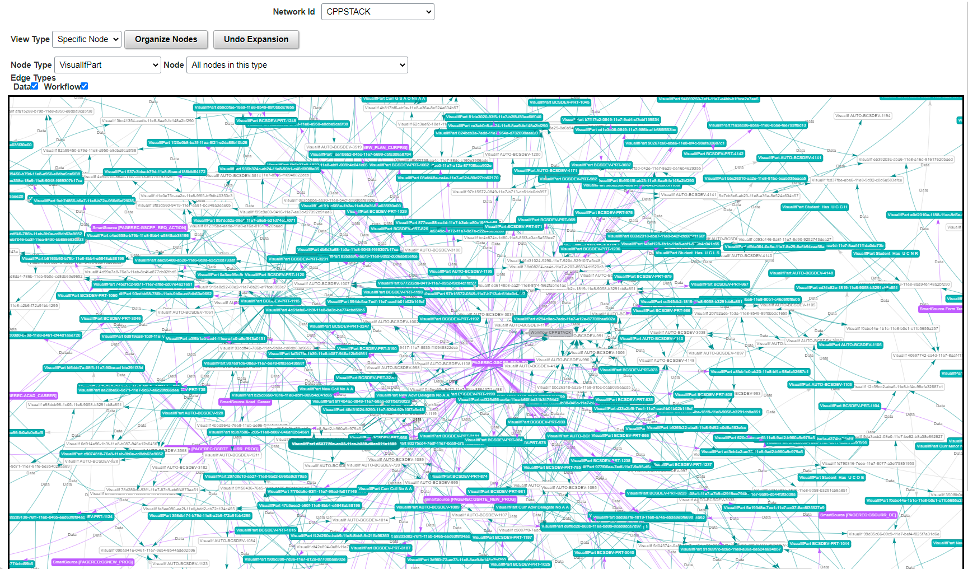
Notes:
And this is what it looked like. This is the Dependency Network Visualizer for our Change of Program Plan form. This is looking at the configuration-based logic (also known as visual if’s). The boxes here represent visual if’s and what they connect to throughout the form and workflow. As I had mentioned before, the flexibility of this tool is really highlighted here and showcases a complex business process case.

Slide 7
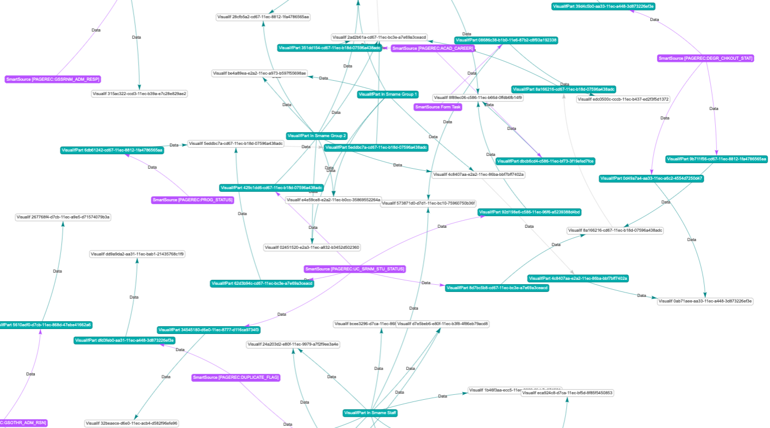
Notes:
On the other hand, this shows a simpler case, our Legal Name Change petition. There is still logic there but did not require heavy logic.

Slide 8
Oh the Possibilities – Highway to the… Project Analysis
Request Variations: Hundreds
Partner Differences: No Consistency or agreement among various partners
Bad Idea of Good?: 18+ Forms into 1
Change of Academic Program Plan
Notes:
Continuing in the analysis phase of the form:
Not one college was like the other, each had unique processes:
We had partnered with our 5 undergraduate colleges and the Graduate Division. Getting everyone to agree on a common approach was a huge feat.
Each Undergraduate college handled these requests differently and the over 100 + departments within the colleges also handled these requests differently.
Graduate division wanted submission capabilities for both advisors and students
Undergraduate colleges wanted advisor submission only.
Building the form through configuration
When accessing whether to handle single requests within a form or multiple requests, we found that single requests kept the form build simpler, particularly with field configuration based logic and workflow logic.
Introducing multiple requests exponentially increased the complexity
So we decided to move forward with single actions on the form unless the actions were related, an example would be adding a major that has a subplan. In this case we combined the request into one.
Building the logic
There was logic built into nearly every aspect of this form including
Pages, Segments (which make up parts of a page and combine similar fields), fields, workflow, attachments, notifications, acknowledgments, etc
Workflow requirements for each college were unique
The key to building the workflow for this form was finding the commonalities among the colleges

Slide 9
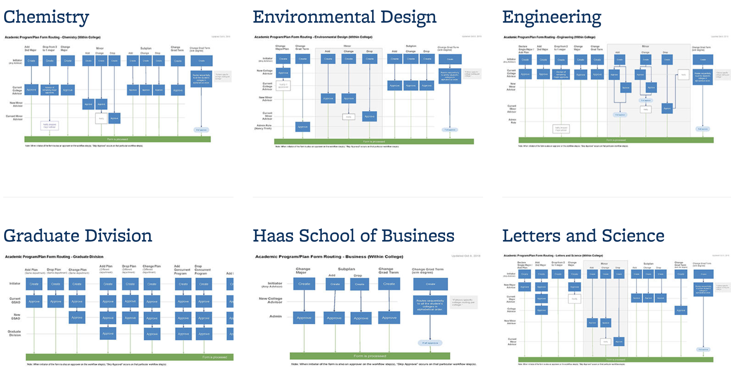
Notes:
This is the workflow guide published on the university site to assist students and staff in understanding the workflow of the form
As I had mentioned before, finding the commonalities helped simplify the workflow as much as possible.
Commonalities included advisor routing and how we determine which advisors should be approving requests based on the request and the students existing program plans.
We built the bulk of the workflow based on each college and built specific workflow for 3 request types that could be shared among the colleges due to their similarities.

Slide 10
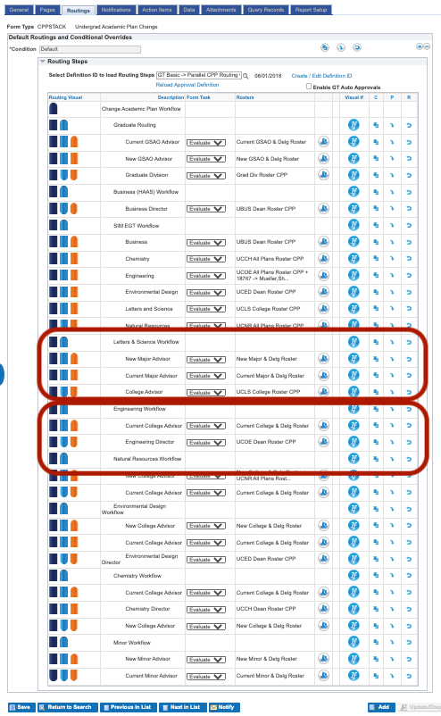
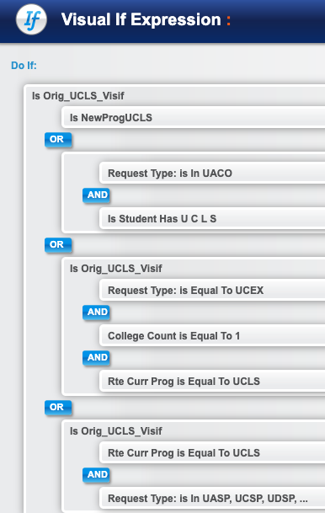
Workflow Breakdown At a Glimpse
Notes:
To the left is the entire AWE approval definition workflow we built for this form.
Within this workflow you can see groups, these are the groupings I described earlier. These are called paths and paths can have several steps within them.
Building the routing based on Paths with steps would allow each workflow path to process independently from one another from start to finish.
This means if a student request required workflow in the Letters and Science Path (as you can see here in the path highlighted in the bottom image) and Engineering Path the workflow would start at the same time.
The workflow completes once all paths and steps involved have acquired all approvals

Slide 11
Oh the Possibilities – Highway to the… Project Analysis
Request Variations: Hundreds
Partner Differences: No Consistency or agreement among various partners
Bad Idea of Good?: 18+ Forms into 1
Change of Academic Program Plans
Notes:
Finally, reviewing this project with experience under our belt we determined we could do better and requirements of the student request were evolving.
Since the original form was completed, maintenance and enhancements of this form have complicated due to the various moving parts in this one request.
If workflow changes were needed, which initially happened often, retesting could be significant.
Configuration-based logic changes also required significant testing due to the variations in requests and how they interact with one another.
Finally, Graduate Divison wanted to open the form for student submissions
This form is heavily used with over 102,000 submissions since Late 2016, it was critical to improve the experience for our users.
Moving forward, we have been in the process of separating out Graduate Division from the Undergraduate colleges and building forms that would be easier to maintain and modify along with providing a better experience for our partners.
The Graduate Program Plan Request
Has been broken down into 2 different requests: Program/Plan Changes and Expected Graduation Term Changes
We are currently in the development phase of building 2 undergraduate forms as well
One that handles Degree Plans – Majors, Minors, Subplans, Expected Graduation terms, Requirement terms, certificates
And the other Degree Programs – College Level requests
What I hope I highlighted here is that this tool can really handle complexity or simplicity. In some cases the complexity is great, in others, like our Change of Academic Program Plan form.

Slide 12
Undergraduate Change of Academic Program Plan Demo
Notes:
This is the original CPP form which is still in use in production by undergraduate adivsing.
I will walk through the submission of a request and highlight the variations I mentioned earlier.

Slide 13
Our Most Recent Projects: To ReForm or Not to ReForm
Legal Name Change Petition
2 PDF forms Manual Updates to System Email Workflow
P4 Level Data
Late Schedule Change Petition
COVID-19 ER Project MVP Continuous Enhancements 1 College to 2
Statement of Legal Residency
Custom CS Pages Technical Maintenance Y/N Slider/Checkbox
ReForm
ReForm
No ReForm
Notes:
Legal Name Change Petition was identified as a good candidate for an eForm project due to several factors:
There were two PDF forms as part of the process: One for Alumni and the other for active students
Form submissions, workflow and communications were done through email
Updates were manually completed by OR staff once the form portion of the process was completed.
The data needed to ensure the legal name change request was valid included data that is designated P4, by UC standards which requires the highest level of protection.
Email communications were no longer a secure way of acquiring this information.
Campus Solutions is P4 Level secure
The form build was Medium on a scale of Small to Large effort of Complexity, we built a page updates into the form which update students to update Legal Name, Diploma Name and preferred last name update.
All notifications are automated
The document trail is contained within the form through workflow recycle functionality
Historical Name data is displayed for staff within the form for ease of approvals
If the updated name in the form is contained in the historical data, the form logic bases the request off of a correction which changes the requirements from the student.

Slide 14
Recent Projects: To ReForm or Not to ReForm
Late Schedule Change Petition
COVID-19 ER Project MVP Continuous Enhancements 1 College to 2
Legal Name Request
2 PDF forms Manual Updates to System P4 Level Data Email Workflow
Statement of Legal Residency
Custom CS Pages Technical Maintenance Y/N Slider/Checkbox
ReForm
ReForm
No ReForm
Notes:
Late Schedule Change Petition – This form has been an iterative and started out as a small effort request to alleviate the influx of requests anticipated due to Covid-19.
Over the past few terms has been evolving into a more complex, automated, intelligent process.
This form started as an emergency request to handle late drops for the College of Letters & Science
The number of late drops was expected to rise due to the effects of Covid-19.
The potential estimated staff hour savings was over 100 hours with over 3,000 requests submitted.
Form went through the SDLC process in 9 days and was running in production on the 9th day.
Displayed student’s enrolled classes and allowed student to select from list which courses they wanted to drop
Configruation based logic and custom logic validations allowed for auto-approval of the requests under most circumstances
Ongoing enhancements under development now include
Adding College of Engineering student/staff submissions
Adding Classes
Grading basis and Unit Changes
Maximum unit approvals
Lab/Lecture co-requisite de-coupling exceptions
And Department Error corrections
Adding Service Indicators to track the number of late actions a student has taken:
Letters and Science: A total of 2 late actions
College of Engineering: A total of 2 terms of unlimited late actions

Slide 15
Late Schedule Change Petition Demo
Notes:
This is the newer Graduate Change of Academic Program Plan form that was built to replace the use of the original form just demoed. This submission is advisor based and utilizing an eForm tile we created for Graduate Advisors.

Slide 16
Recent Projects: To ReForm or Not to ReForm
Statement of Legal Residency
Custom CS Pages Technical Maintenance 300+ Questions – Y/N
Legal Name Request
2 PDF forms Manual Updates to System P4 Level Data Email Workflow
Late Schedule Change Petition
COVID-19 ER Project MVP Continuous Enhancements 1 College to 2
Legal Name Request
2 PDF forms Manual Updates to System P4 Level Data Email Workflow
ReForm
ReForm
ReForm
No ReForm
Notes:
Statement of Legal Residency has been handled through custom built pages and tables in CS. This process was refactored a couple years ago and still needed technical refactoring
There is a heavy technical burden when it comes to maintenance and updates to this custom application.
We were hoping to rebuild the process with a form.
During our Analysis
We realized the design of the current process and the formatting would not be replicable and due to the number of questions (300+) the available field options would not work.
We would have needed to customize field options which meant potentially changing Campus Solutions framework for checkbox logic in fluid.
This effort is not finished. As functionality continues to evolve, we will revisit moving this process to an eform

Slide 17
Recommendations: Starting Form Projects
Solid Specification/ Design Template
6 Years and Still Transforming
Continuously review and improve Specification Templates
Templates should walk through all the areas of form and form process
Change Management
Remember Change is Hard
Patience, guidance and compromises go a long way.
Start small and work your way up
Highlight the benefits of moving to an eForm
Stick to Standards
Where you can…
Naming conventions
Standardization of form setup
Remember Innovation Takes Time
Focus on Continuous Improvement
Review code and configuration on a regular basis
Apply new functionality to replace antiquated work-arounds
Manage Expectations – Avoid Scope Creep!
Nearly impossible.
Iterative Development: Pros & Cons
Bells & Whistles right out the gate
Simple to start
Notes:
When you begin your eform projects some things to keep in mind:
Having a specification template that captures all the areas of a form and workflow build: From form parts to query records…
We are 6 years into building forms and are continuously improving our specification
Identify Standards, preferably before you begin projects
This has been iterative for Berkeley
As we worked with forms and became better familiar with the inner-workings, our naming conventions evolved
Keep in mind that you will continuously find ways to improve standards, and these will change.
Naming conventions also tie heavily into standardization of form setup
Keep in mind that innovation takes time.
Even replacing a pdf version of a form with an eForm is a redesign
Always improve
As new releases and new functionality are delivered by Gideon Taylor, review your forms to see where you can easily improve and do it.
Small wins are great ones!
Change Management In the beginning of our form experience, this was a significant challenge – convincing partners replacing their processes with eForms would be good.
One of the concerns form our partners was
Access – if eForms are more readily available, submissions will increase and inundate staff.
This has not been the case for any of the forms we have built for the processes across campus.
Keep in mind that normally, these request result in some kind of action happening with the students record.
Manage Expectations – Avoiding Scope Creep
This is usually impossible to some degree.
Managing it is important because it could mean an on-time delivery of your project or pushing it out.
As partners become more experienced with forms and their capabilities, they tend to request more: Automation, Validation, etc.
The best way to begin is starting simple.
As your team becomes more familiar with functionality, setup and the ability to reuse code across requests that are similar, building more complex forms will get easier.

Slide 18
When I create any dish, literally the first thing I think of is, what is the purpose behind this dish? Why am I putting this ingredient in it?
- Esther Choi
Notes:
The longer I work with eForms the more I realize it is like building a great dish. Being a chef of eForms can be an incredibly satisfying experience for BSA’s and Developers, especially if the effort is collaborative. At Berkeley, we work hand in hand with our developers and this has led to incredible success. I will give a shout out to Ken Hensel, our eForms Technical expert for the many hours of working sessions and breakthroughs that have led us here. Let me Segway with this quote…

Slide 19
The Ingredients! Form Parts
All in the Family – Form Families & Tasks
How will you group your forms together?
Important? Not so Important?.
Pages, Segments, Fields, Acknowledgements, Attachments
The building blocks.
Visual Ifs
The neurons of functional logic!
Simple/Complex
Form Security
4 Levels:
Form User – Link API
Participation Rosters -
Search Settings –
Workflow -
Notes:
Now to get into the Ingredients of an eForm! For everyone attending, I am assuming there is varied levels of experience and/or curiosity with regards to GT eForms and workflow. I will cover these areas high level and drill down in some cases that might be a bit more advanced.
Starting with Form Families: Getting these right from the get-go used to be critical.
Families share search views meaning in order for a group of end users to view all of their various forms in one place, they had to be in the same family.
That is not the case anymore and creating form families can really be based on grouping similar forms together, whether by department or student career, just as examples.
What changed?? Search Sets

Slide 20
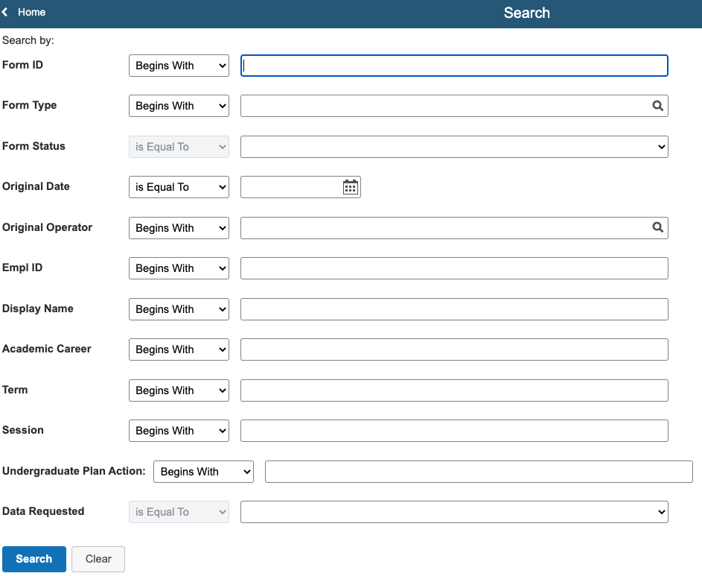
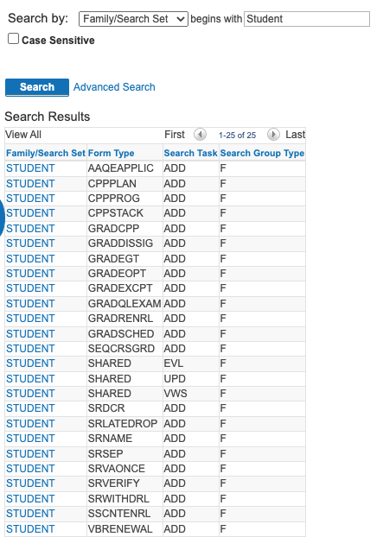
Before Search Sets
Notes:
Before Search sets there were shared searches by task (View, Update, Evaluate and Add in some cases) per form family.
This shared setup had limitations
All forms where users needed to view, update, or evaluate their forms were required to be in the same form family.
If they were not in the same form family, unique links for each family/task combination would need to be provided to users to view all their forms.
They would only be able to view the forms within the family they selected the link for.
Other limitations we found were
Performance issues
Now that we have hundreds of thousands of forms, for users that can see a large set of these forms, searching without several parameters can take significantly longer.
Search and Result fields
New forms added to the family were required to conform to the existing search and result fields with little room for additions as the family grew.
Limiting the form search field keys made filtering results not as efficient as they could be.
I have highlighted an example of our Student form family that we created when form projects began.
All student forms needed to be under the same family, including Grad, Some Law, Undergrad and Non-degree seeking students.
As you can imagine, this mix required very specific security limitations, as well.

Slide 21
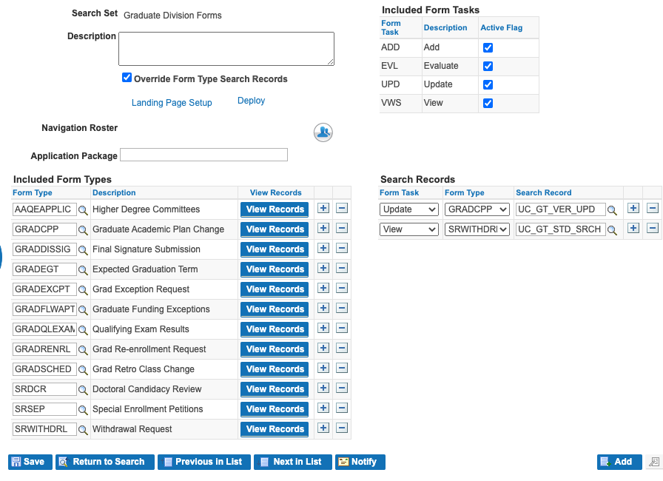
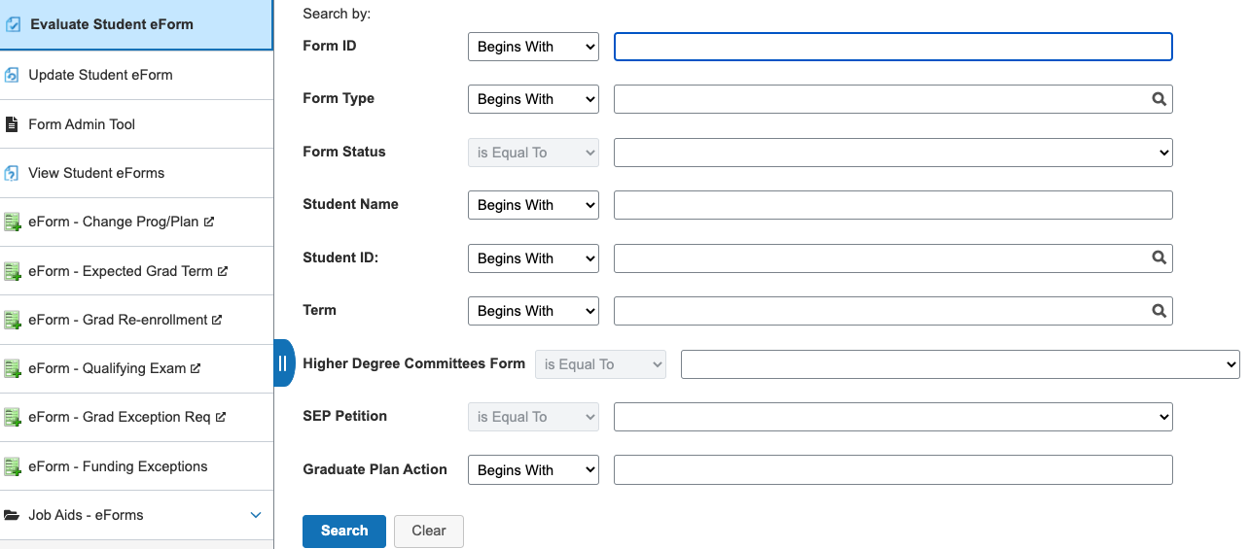
After Search Sets
Notes:
After search set functionality was added, Form Family and search requirements changed.
Search sets introduced the capability to group forms into smaller specific sets, including forms that were shared across various groups (Berkeley examples would be Term withdrawal, where Graduate and Undergraduate students use the same form)
This allowed for a more precise search field configuration that is specific to these groups
Along with customizing the search setting views, again specific to the smaller subset of forms in the search set
It also allowed for flexibility to create new search set while also continuing to use form family searches.
This is an example of a search set built for Graduate Division suite of forms, used by students and staff into one. These forms were originally in the Student form family.
The fields configured in this search are specific to this set of forms
This also gave us the ability to create links for the search sets and replace the form family add and search links with search set links where it was a better experience.

Slide 22
The Ingredients! Form Parts
All in the Family – Form Families & Tasks
How will you group your forms together?
Important? Not so Important?
Pages, Segments, Fields, Acknowledgements and Attachments
The Building blocks.
Visual Ifs
The neurons of functional logic!
Simple/Complex
Form Security
4 Levels:
Form User – Link API
Participation Rosters -
Search Settings –
Workflow -
Notes:
Moving on to Pages, Segments, Fields, Acknowledgements and Attachments.
I bundled these together because these are the parts your end-users will see and interact with in the form portion of their experience.
There are several approaches we have taken throughout the years with regards to these pieces and I will walk through a couple.
Pages
Most of our forms are 1-2 visible pages. There are exceptions to this but they are few.
Many of our forms have what we call a landing page or instructional page.
This gives us the opportunity to perform validations without letting the user directly into the form until validations are passed.
This format has been very successful and continues to transform as we rebuild forms
The second page is the actual request that is being submitted for review.

Slide 23
Common Segments
Notes:
Utilizing Segments is a way to group similar fields together or change the format of the fields from column to grid.
We do have common segments that we use in most of our student related forms.
HOWEVER, we do not reuse these segments.
Early on we attempted to see if we could save time by building a one segment fits all student information and Program/Plan information segments
What we realized was that every use case was different and the ability to accommodate those differences was critical, so we create new ones for each form but they have a similar look and feel.
It didn’t take much convincing since building segments was easy enough Easy enough Fields on the other hand can be reusable across forms because they are based on the form type.
Fields within segments can be reused across forms and this is where your well thought out naming conventions come in handy.
A good example is student Id.
This field is used in nearly every form… could you imagine creating a new field in every form type? You would have the same field in so many different name iterations
Record Tags (basically a way to categorize your fields) on segments allow for that reuse. Column segments, generally the type of segment we use for student information, carries the same Record Tag across forms.

Slide 24
The Ingredients! Form Parts
Notes:
Acknowledgements are a powerful tool when requiring users to accept certain terms or conditions.
These acknowledgements are required for form submission.
By utilizing the visual if’s on these acknowledgements, we have been able to refine the agreements to very specific groups that meet certain requirements, ie. Student Athletes or specific college agreements
Attachments and the logic capabilities have also become a valuable tool
Preset Attachment Descriptions that are configurable become a drop down for the users to select from a list the available attachment submission options.
Logic allows attachments to be shown or hidden, required or non-edit based on the user.
Individual instructions on each attachment Description provides direct information to the user as to what is expected from the attachment either required or selected.
We have utilized all of these in various capacities from simple to complex.

Slide 25
The Ingredients! Form Parts
All in the Family – Form Families & Tasks
How will you group your forms together?
Important? Not so Important?
Pages, Segments, Fields, Acknowledgements and Attachments
The Building blocks.
Configuration Based Logic (Visual If’s)
These are the neurons of a form.
Functional logic can be simple or complex.
Form Security
4 Levels:
Form User – Link API
Participation Rosters -
Search Settings –
Workflow -
Notes:
Visual if’s are the neurons that make the motions happen in forms.
From very simple delivered to highly complex custom there is a lot of flexibility at the hands of a functional analyst using these little power houses.
Functions of visual if’s include: Do if and/or statements for hiding/showing, requiring and display only.

Slide 26
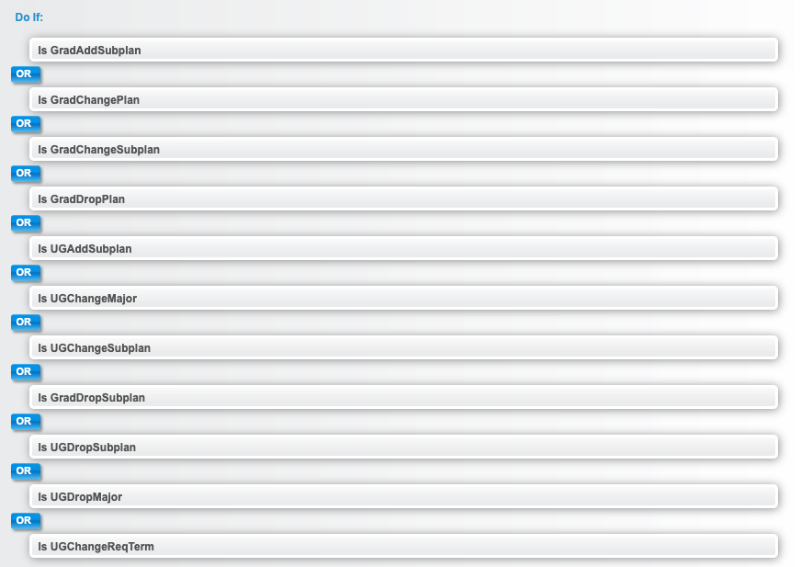
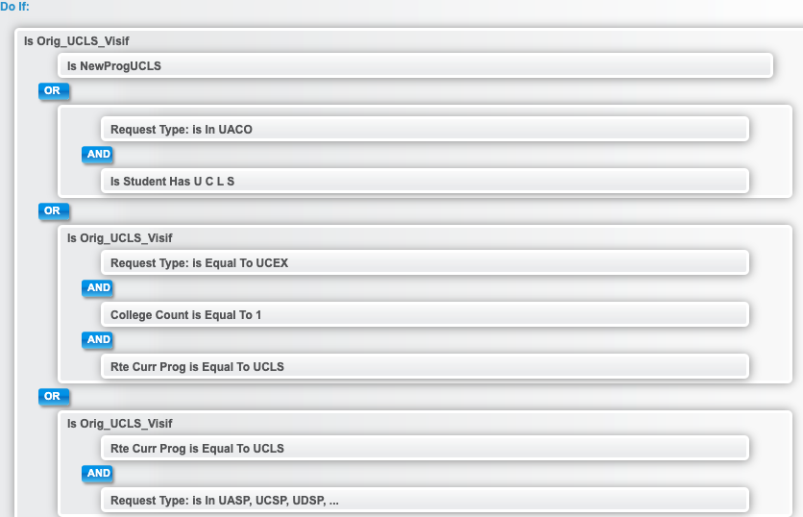
Visual If’s
Notes:
Here are a couple of samples of visual if’s on our Change of Academic Program form.
The first example uses logic parts alone, contained in the single boxes
The second example is using logic parts and logic groups, where logic can be nested in other logic.
This is the bread and butter of what makes these forms so flexible.

Slide 27
The Ingredients! Form Parts
All in the Family – Form Families & Tasks
How will you group your forms together?
Important? Not so Important?
Pages, Segments, Fields, Acknowledgements and Attachments
The Building blocks.
Visual Ifs
The neurons of functional logic!
Simple/Complex
Form Security
Form User
Participation Rosters
Search Settings
Administrative
Form Security
4 Levels:
Form User – Link API
Participation Rosters -
Search Settings –
Workflow -
Notes:
There are 4 key parts to security:
Form user roles: High Level, these are the delivered GT security roles that differentiate a user from a functional analyst to a developer.
Participation Rosters: Control which users can access each form. These rosters are task associated.
Search Settings: These are customized views that controls the form data that is displayed when search for forms in the form searches. This is also task level configuration.
The Admin Tool is a powerhouse for administrative actions:
At Berkeley security is tightly controlled for this tool
Newer delivered functionality (version 3.30.04) gave the ability to control the functions of the tool based on the user. This has allowed us to reconsider admin access for our partners based on their experience and training on admin tool functionality.

Slide 28
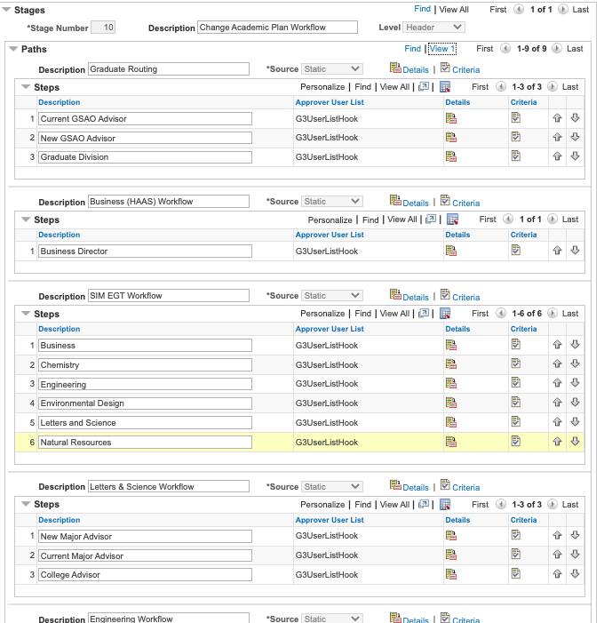
The Ingredients!(cont) The power of Workflow
AWE Approval Workflow & Customizations
GT Delivered Basics Custom Approvals Config
Routing
Defined Rosters Group Rosters Role Based Route Controls + Roles Query Smartsource External User by Email SQL Object User
Notifications
Utilizes Rosters
Event Triggered
Logic Based
Rich Text Template Configuration
Notes:
GT eForms utilizes Peoplesoft AWE approval builder and engine workflow on forms.
GT delivers 1-10 step pre-built approval definitions
There is also the option of building custom approval definitions.
Here is the AWE approval definition for the CPP form I highlighted earlier. This is a custom approval definition built for this form and utilizes the GT application class for visual if’s for both the paths and steps.
Going into the structure of these approval definitions we have:
Stage level
Stages include paths and steps
A stage needs to complete before another stage is triggered in the workflow. on to the next stage in an approval workflow.
Path Level – the benefits of paths are that
Multiple paths can be in motion at the same time and are independent of one another, highlighted in the Change of Academic Program Plan example.
Paths also contain steps
Steps are linear behavior and trigger one after the other

Slide 29
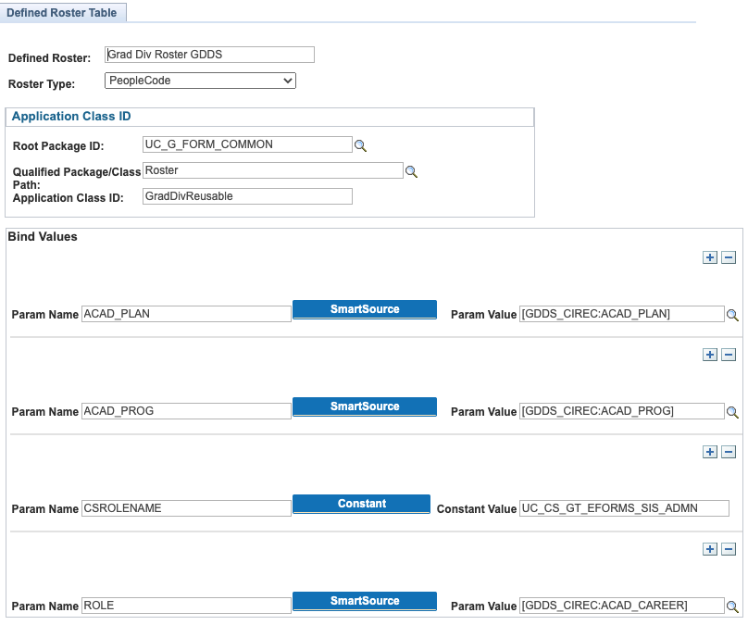
The Ingredients!(cont) The power of Workflow
AWE Approval Workflow & Customizations
GT Delivered Basics & Custom Approval Definition Configuration
Routing
Defined Rosters Group Rosters Role Based Route Controls + Roles Query Smartsource External User by Email SQL Object User
Notifications
Utilizes Rosters
Event Triggered
Logic Based
Rich Text Template Configuration
Notes:
There are various ways to set users to the approval definitions built. I will talk to some of the common ones we use.
In nearly all our forms we have built, we used defined rosters. That is the image you see to the Right.
Through defined rosters we are able to designate advisors by role and determine the majors they oversee using setup pages that existed.
This gives us the ability to route down to the subplan a student has.
These rosters can require development, but is minimal effort and reusable once built using common/shared code
Group rosters
The benefit of this roster type, is that you can build a roster on the fly by simply adding users.
This works great for small groups that do not change regularly.
However, if the roster changes, configuration updates are needed.
Role-based is another common one we use.
We do create customized roles for our forms when needed but also try to reuse existing roles where we can, which is not common.
Route-controls + roles
We use this on one of our forms where we needed a way to designate departments.
The route controls allowed us to build the departments route controls and the assign those route controls based on a role.
Again, maintenance is usually required for this routing option.
We have not used Query based routing yet but the option is there.
Smartsources we have used and can be custom development.
GT does a great job delivering common smartsources like original oprid which save a lot of time.
External User by Email
We used this for the first time in a form build where signatures (form approvals) were needed from external users. We used tokens through email notifications to allow these guest users to approve the forms.

Slide 30
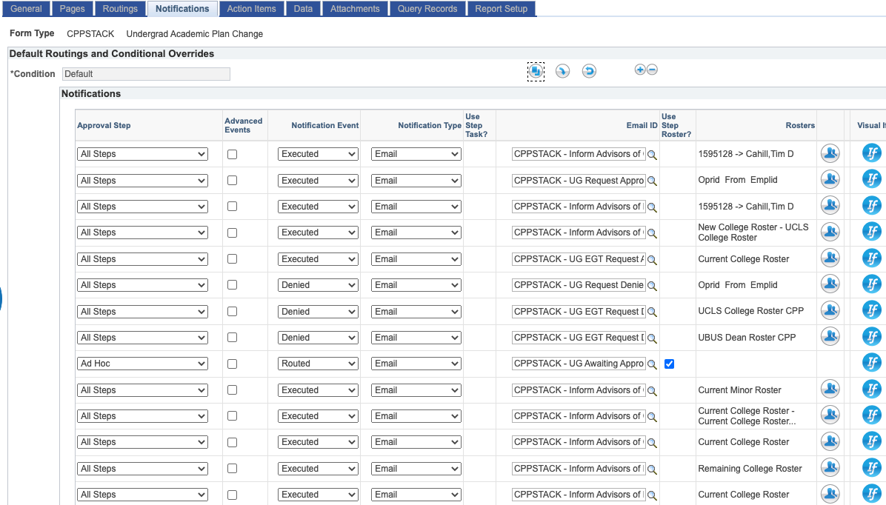
The Ingredients!(cont) The power of Workflow
AWE Approval Workflow & Customizations
GT Delivered Basics & Custom Approval Definition Configuration
Routing
Defined Rosters Group Rosters Role Based Route Controls + Roles Query Smartsource External User by Email SQL Object User
Notifications
Utilizes Rosters
Event Triggered
Logic Based
Rich Text Template Configuration
Notes:
Notifications are incredibly flexible.
They can also utilize the same routing options as workflow. To the right is a snapshot of the CPP form notifications that are automated, there are a total of 31 for that form.
These notifications are event and configuration based logic driven.
The templates are built from Rich Text configuration.

Slide 31
The Ingredients!(cont.) Data
Data Pool
That one ingredient that ties the whole dish together
Auto-population
System Updates
Component Interface Query Based Updates
Query Records
Reporting
Notes:
I will just quickly step through these last 3. There could be an entire advanced session on these, but for purposes of this webinar I just want to highlight what they are.
The data pool is really all the herbs and spices that give the eForms their flavor. It pulls the whole dish together.
This is where you house the views that you are pulling data into the form from and connecting fields for autopopulation of data, prompt and dropdown options, etc.

Slide 32
The Ingredients!(cont.) Data
Data Pool
That one ingredient that ties the whole dish together
Auto-population
System Updates
Component Interface Query Based Updates
Query Records
Reporting
Notes:
We handle system updates 3 ways:
Within the form, we build component interfaces to update Campus Solution pages and/or tables: An example would be the Legal Name Change Petition that updates Biodemo data on the student record with the student’s legal name.
Outside the form we use form query records to setup Query Based Logic updates or QBU’s.
There are existing processes/engines that run based off page updates as well.

Slide 33
The Ingredients!(cont.) Data
Data Pool
That one ingredient that ties the whole dish together
Auto-population
System Updates
Component Interface Query Based Updates
Query Records
Reporting
Query Records
Reporting
Notes:
Query records are fairly self-explanatory.
I will highlight that some of our processes that we have built using forms and workflow were never tracked historically. Using forms for these processes has provided the ability to review some of these processes quantitatively. Query records provide the ability to maintain a record where records may not exist.

Slide 34
Power in Numbers
Form Interactions: Form initiations
700,000
Paper/PDF forms, Google forms, and memos replaced.
110+
Notification Templates Built.
215
Over the years forms have saved thousands of staff hours. Estimates are based off partner estimates of time per request from start to completion vs. time eform process takes.
1000’s of Staff Hours Saved
Notes:
Just some quick numbers of where we are in with our forms.
We are nearing the 700,000 mark with regards to form interactions. If these were paper-based or pdf-based forms, this number may have been double or more.
We have replaced 110+ Paper/PDF, Google forms, memos and various other disparate form processes using GT eforms.
There are 215 automated notifications that exist. Replacing the need for sending emails back and forth.
1000’s of staff partner hours saved with these forms. This is a general estimate based of of analysis done at the beginning of each project to determine how long the existing process from start to end takes before we replace the process with an eForm.

Slide 35
Form Resources
HEUG GT eForms User Group Community & Discussion Board
Notes:
I will end with this. The HEUG GT user community is an incredible group. If you have not already, I highly encourage you to join the discussion board no matter the eform space you are currently in. If you are interested , are just starting out or advanced… this group is responsive and supportive.

Slide 36
Questions?
Notes:
We can now open the session up for questions.

Slide 37
Thank YOU!
Please feel free to reach out for more information, questions or networking!! Email: alloyd@Berkeley.edu

