Slide 1
Revolutionizing the Campus Experience with PeopleSoft-based GT eForms at UC Berkeley
Session Number 4010
Day, October ##, 2022

Slide 2
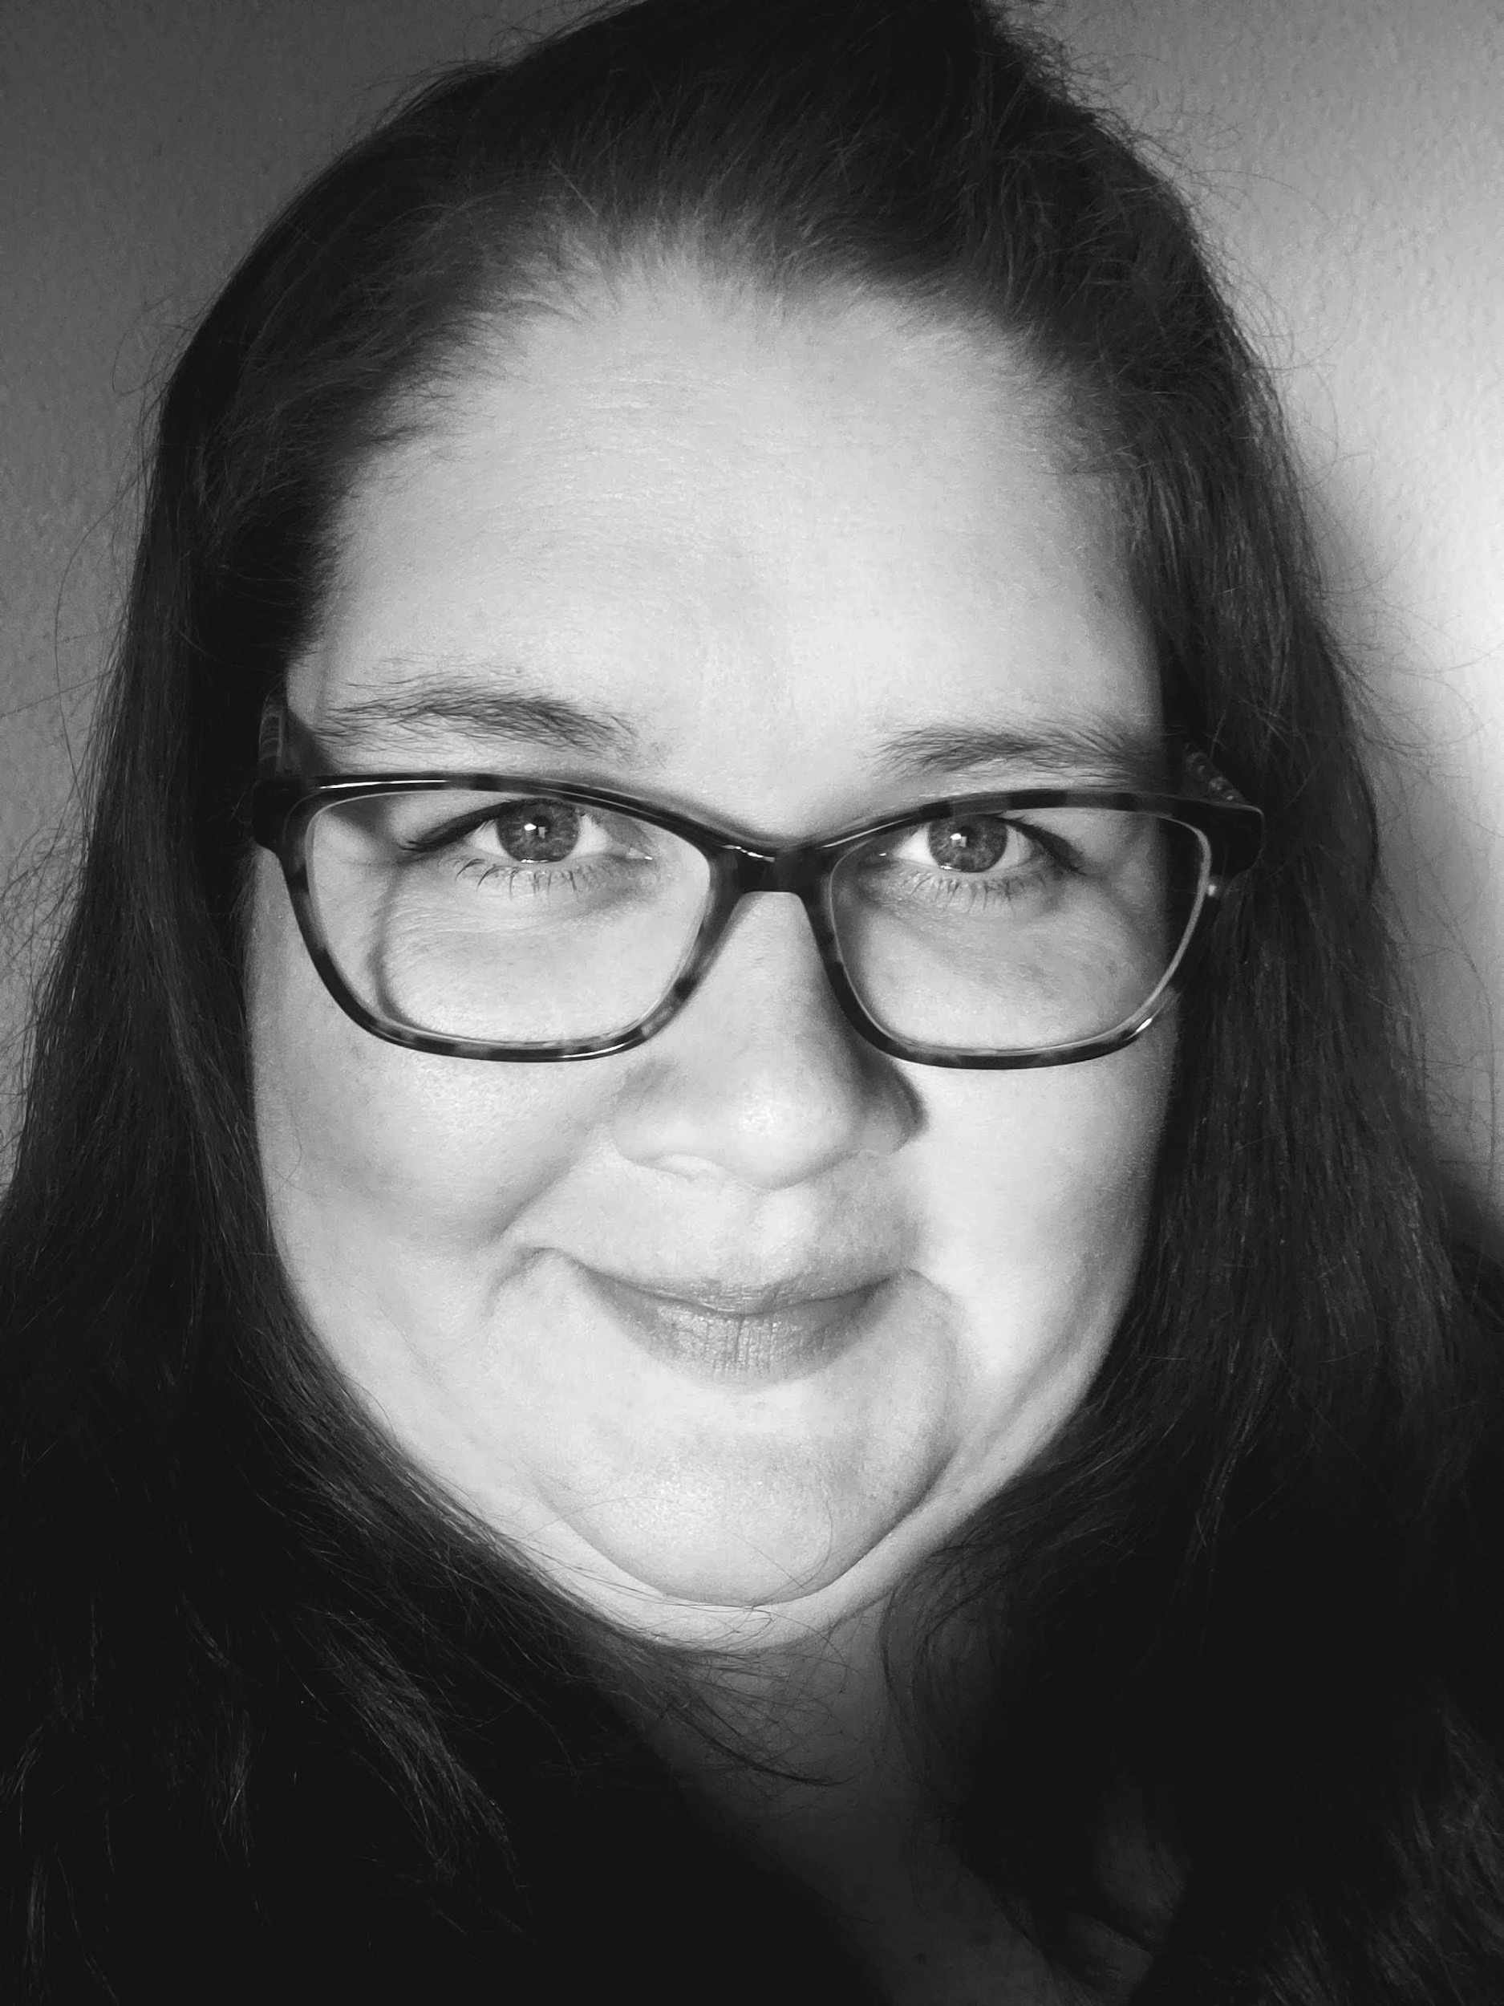
Presenter
Andrea Lloyd
Senior Business Systems Analyst
Leading Berkeley eForm efforts since 2015. Expertise in Campus Solutions the following modules Admissions, Records(Enrollment, Curriculum Management), Transfer Credit, Financial Aid, Advising, Campus Community.

Slide 3
University of California, Berkeley
Berkeley is situated roughly 15 miles from San Francisco in what is known as the Bay Area
Founded in 1868
#1 Public University tied with UCLA, 2022 US News & World Report
Admissions (Fall 2022 Undergraduates)
147,596 Applications
19,803 Admitted
Enrollments (Fall 2021)
Undergraduate: 31,814
Graduate: 13,243

Slide 4
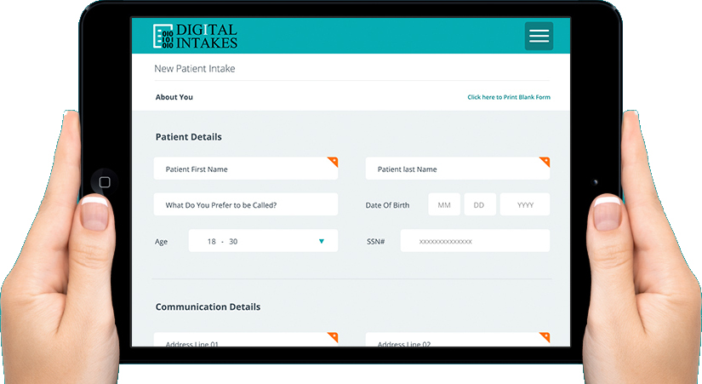
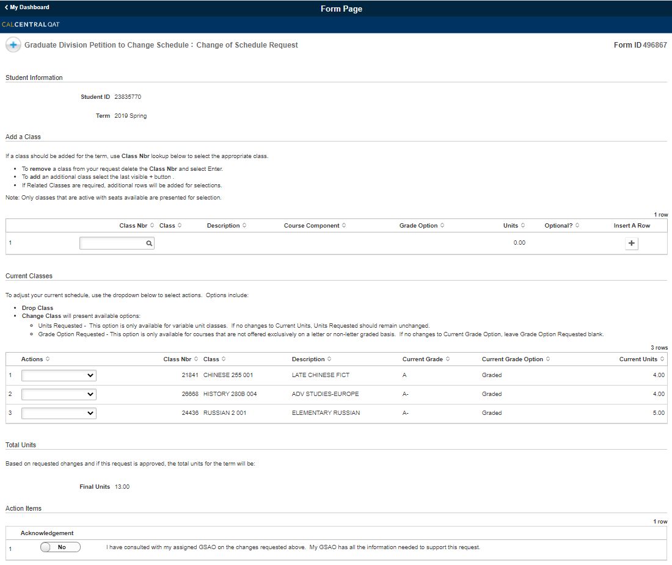
Capabilities
IT Functional - Configuration based work
Fluid
Conditional Logic/Validations
Workflow/Approvals
Notifications
Customizations
Data Pre-population
Form Records
Security
Text
Attachments
Acknowledgements
Form Migrations
IT Technical - Development based work
Complex Validations
Customizations
Automated System Updates
Guest User Capabilities (Tokens)
Project Migrations
Notes:
What are the capabilities of GT eForms in combination with Approval Workflow Engine
I am sure everyone has had at least one experience with a paper form in their lives.
Functional Configuration
Fluid
At the click of a button
Conditional Logic
Task Type - Vary the logic when a student/staff/faculty are viewing the form vs. approving the form
Pages, Sections (aka Segments), Fields, Attachments, Acknowledgements, Workflow, Notifications
Workflow/Approvals/Review
Flexibility for Simple to Extremely Complex
Compare Vet Benefit Renewal to CPP eForm
Undergraduate Change of Academic Program Plan Request
25 Departments
Hundreds of different possible routing scenarios based on student’s request and current degree
Ad Hoc
Notifications
Rich Text
Triggered by form events: ie. submission, routed, approved, executed
Ability to include data from the form within the notifications
Links to the form
Final Signature - Token Authentication
Customization
Ability to build something that does not exist
Create new fields
Build pages within CS to house data collected in forms
Tables within forms
Logos, school colors
CSS
Data Pre-population
If data exists in the system, can be pulled into the form to prefill
Form Records
Each can have its own unique set of records or can share a record across forms
Can be utilized in queries
Security
Unique to each form
Simple to Complex
Several levels
Text
Rich Text
In form and notifications
Multi-language support
Form Migrations
Simple Forms with no custom code
Technical Development
Validation/Requirements throughout
Entry into the form
Requirements for submission of form
Updates to Campus Solutions once form process complete
Custom Segments
Automated System Updates
Berkeley does these through a Component Interface or several depending on the form
Tables updated automatically
Guest/Off-Campus Users
Project Migrations

Slide 5
Benefits of Dynamic Digital Forms at Cal
Building, Reinventing and Improving our Processes
New Process Design
Bridging Process Gaps
Material Consumption
Tracking
High-Volume
User Experience
Self-Service
Increasing demand for better technology
Combined Experience and Improvement
Accuracy
Accountability & Quality Control
Access
Flexibility
Time
Notes:
Assessing the Value of Digital Transformation
Improving our Processes
Bridging Process Gaps
Business requirements not met through Campus Solutions
Examples include
Law Students - Intent to take the Bar Exam
Prior to eForm there was no method of collecting and tracking this information
Student formed Graduate Committees
Materials
Paper, ink, printing supplies, misc
Reduction in consumption paper
Reduced Carbon Footprint
Physical storage and access to form data
Removing the need to transport documents across campus
Tracking
Ease of access to data
Data based decision making
High-Volume Process Requirements
Thousands of requests per day
Bulk Approvals
User Experience
Self-Service
Putting the power in the hands of our students, staff and faculty
Technological Expectations
Growing Demand
Exponential growth of sophisticated technology
Mobile Access
Both
Accuracy
Information that is in the system utilized
Information entered can be validated
Accountability & Quality Control
Chain of custody
Who is seeing and approving requests
Optional active monitoring of workflow
Physical loss of requests
Access
Forms are readily accessible - Anywhere… Anytime…
Fluid allows easy access from any device
Flexibility
Covid-19
Time
Ability for rapid responses/approvals
Workflow triggered upon submission
Notifications triggered upon various form actions
Updates to campus solutions triggered through form actions
DCR
Test results upon submission
Faculty assessment - upon completion

Slide 6
eForm in Under 5 Minutes!

Slide 7
Engaging our Campus Community
Students
Undergraduates
Graduates
Law
University Extension
Staff
Office of the Registrar
Financial Aid & Scholarships Office
Summer Sessions
International Office
Athletics
Disability Access & Compliance Services
Undergraduate Advising
Graduate Advising
Student Financials
Colleges
Berkeley Law
Berkeley Graduate Division
College of Chemistry
College of Engineering
College of Environmental Design
College of Letters & Science
Rausser College of Natural Resources
Haas School of Business
Faculty
On-Campus
Off-Campus
Notes:
Engagement of our Campus Community
Our forms engage nearly all student populations and all colleges within the university.

Slide 8
An Expanding Portfolio
Enrollment Processes
Late Class Schedule Actions
Drops, Add, Units, Grading basis
Term Cancellation
Term Withdrawal
Class Enrollment
Exceptional Enrollment Verifications
Academic
Change of Expected Graduation Term
Add/Drop/Change of:
College (Undergraduate)
Major (Graduate/Undergraduate)
Program (Graduate)
Designated Emphasis (Graduate)
Minor (Undergraduate)
Subplan (Graduate/Undergraduate)
Law Specific
Intention to Take Bar Exam
Jurisprudence Award
Prosser Prize
Academic Rule Exceptions
Graduate Specific
Advancement Committee Creation
Qualifying Exam Results
Qualifying Exam Committee Creation
Doctoral Candidacy Report
Parental Leave
In Absentia
Filing Fee
Internship Leave
Dissertation/Thesis Completion
Funding Exceptions
Academic Exceptions
Readmission
Appointment Exceptions
Additional Forms
Emergency Loan Request
Veterans Benefit Renewal
Course Breadth Adjustments
Multi-Term Course Grading Basis Selections (COVID-19)
Room Scheduling
Legal Name Change Petition
In the Near Future
Department Admission
Credit by Examination
Extend Incomplete Deadline
Freeze Incomplete Grade
Undergraduate Readmission
Reduced Tuition
Retroactive Enrollment Changes
Veteran Benefits Intake Request
Remove Incomplete Grade

Slide 9
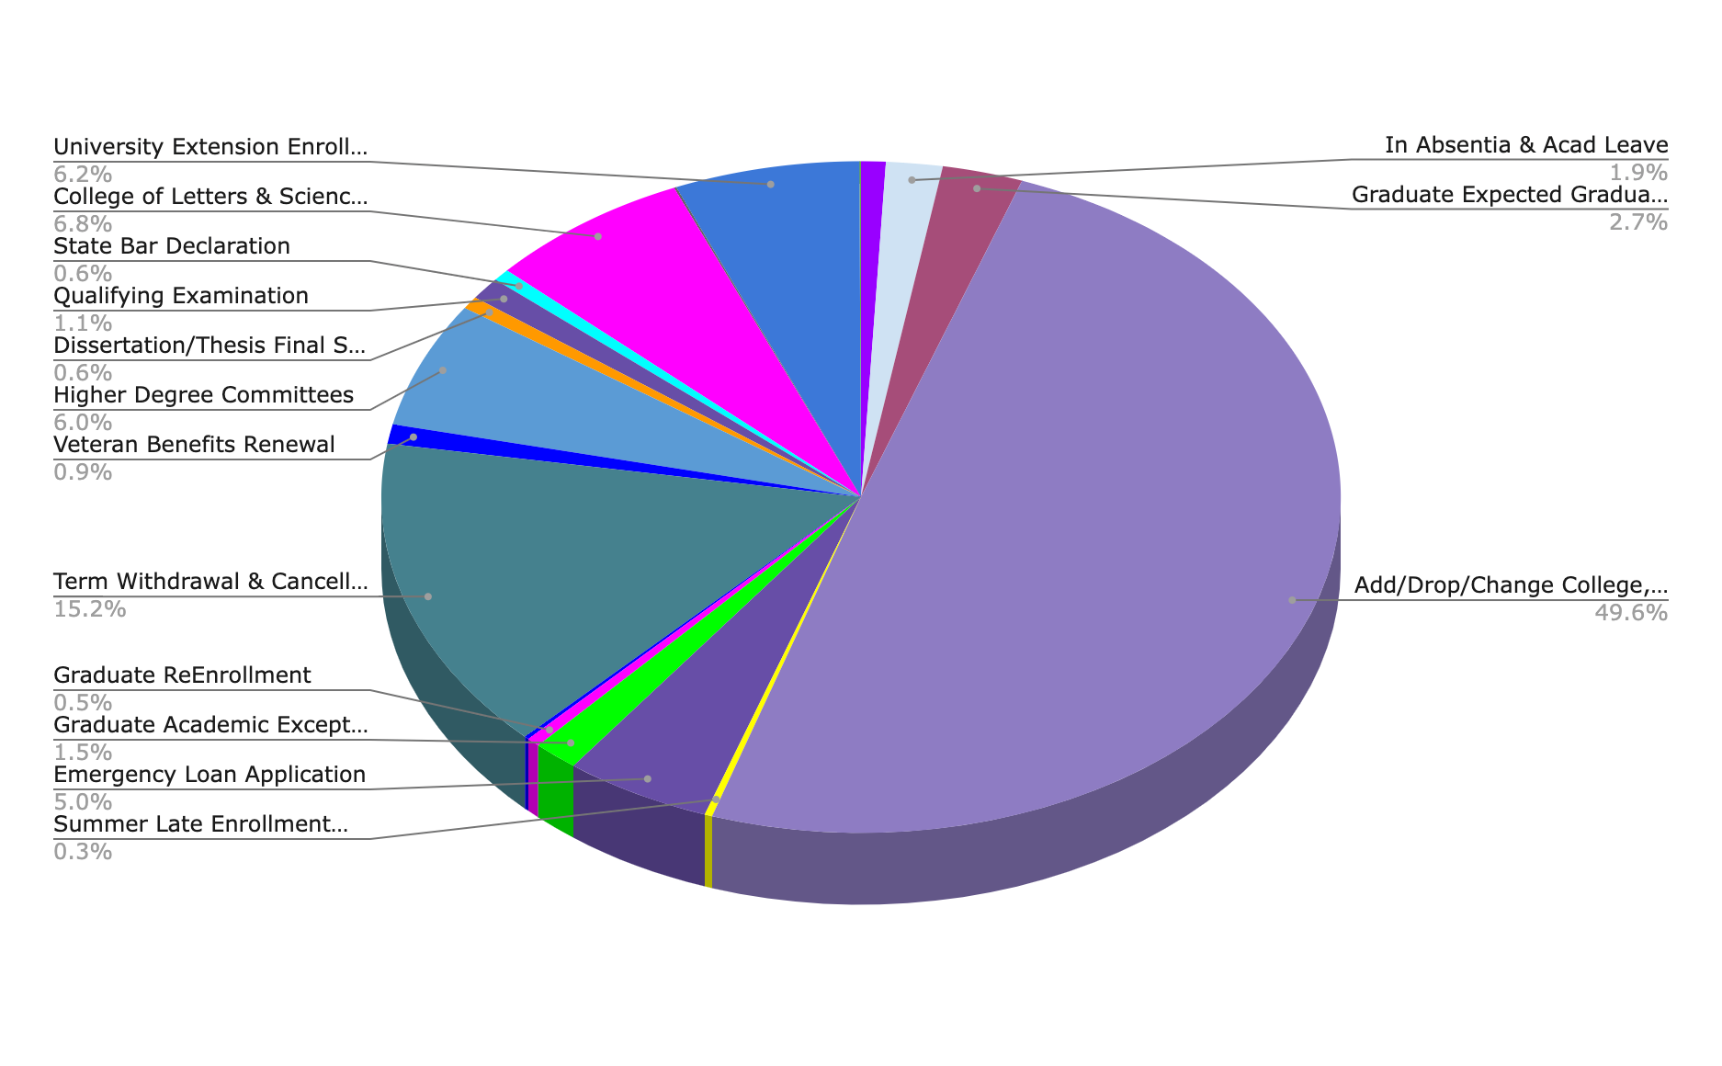
An Expanding Portfolio - Visualized
Proportion of requests over 5 years from 2016 – 2021:
Numbers for 2022:
7500 form submissions per month
250 form submission per day
Notes:
The forms that we have built are solely for the Campus Solutions side of Cal.
A couple notes here:
This is 6 years worth of data but not all forms are 5 years old
The larger percentage forms have all been around for close to those 5 years, like University Extension Enrollment and Undergraduate Change of Academic Plan
These were our big ticket projects we started with
Enrollment and Academic related changes are the majority of the requests that are completed through forms
Graduate Division has nearly completed their suite of forms for the entirety of their business processes that needed forms
Own a majority of the forms

Slide 10
A Closer Look: Late Schedule Change Request
Notes:
College of Letters and Science Late Change of Enrollment
Quick overview of the form:
Scope of manual work that was estimated for our staff was estimated at 100 hours
There was an urgent need to build a way to handle these student requests within a short window of time.
This form was built in 6 days
It handled several thousands requests with minimal impact on staff
Automatic approval under certain criteria
Enhanced each term and continued the use of the form through each of the following terms
Future enhancements to this form will include variable unit adjustments and class enrollment with exceptional requests that will trigger workflow based on the students degree
Demo
First Case
Our forms can be accessed several ways
Access through CalCentral, which is what I will be showing you
CalCentral is our self-service platform for student record information
Most access to student self-service forms is done through this student portal:
the Berkeley.edu site
Checklists
Notifications
Student opens the form
In this case the form has a Landing Page, which is an instructional page based on the request the student is completing and can change depending on the students individual circumstances.
There is Logic happening behind the scenes of this landing page which includes
Determining if the student is an active UCLS student
and if they are currently enrolled in classes
If they are not enrolled they would not be able to proceed into the form, since this form requires active enrollments
The Request Page
Pre-filled information as I described earlier
The students active classes are listed out in the table
The student can now select which of the classes they wish to take action on and what that action is
Various Acknowledgements
These are Required
Highlight Existing Acknowledgements
Mention BIO and Athletics
Comments
Submission
First Student
Logic - Unable to drop last class
Second Case
Select a Class
Acknowledgements
Highlight Athletics specific
Submit
Routing
Highlight Athlete specific routing
Discuss Approval Process and what occurs once form is approved
Form triggers drop action
Custom Fields, Segments and Pages
Existing fields in Campus Solutions
New, Custom fields if fields DNE for use case
Segments (section of form with related data) simple or complex or in between
Validations
Example: Higher Degree Committees
Over 70 different validations within that form
Give a couple examples
Data Pre-Population
As seen in Demo
Automated System Updates
If the page exists in CS, it can be updated
If the page DNE in CS, it can be built and updated
Page can be built to accommodate it with development
Or Form records can be used for reports
Form Records
Unique set of records for each form
Queryable Data
Can build reports off the data
Can be used like any other record in CS
Customized Security is form based

Slide 11
A Closer Look: Graduate Committees
Notes:
Higher Degree Committees
This was one of the first 5 forms we built when we began with forms at Cal in 2016. At that time this was our most complex form. This form handles creation and change of a students graduate committees as the progress through their graduate degree.
4 requests in 1
Qualifying Exam Committee
Advancement Committee
Reconstitution of Committee
Non-Academic Senate Members
Over 70 different validations
A couple of examples are
Checks students degree to determine departments for routing workflow
Runs Committee rules when staff are selected for certain positions with committee
Requests exception if committee rules unmet
Checks if selected members have served in previous committees for that student

Slide 12
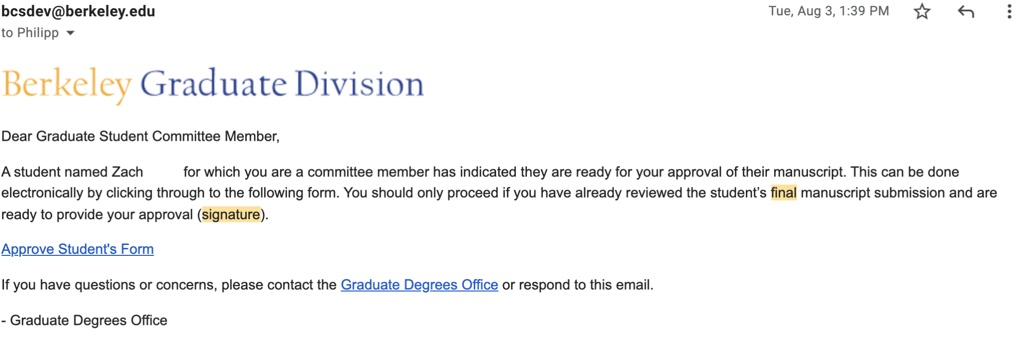
Approvals Through Email
Final Signature Submission
Guest Approvals through token validations
Email Access
Notes:
Graduate Division - Final Signatures
Overview: Part of the Graduate Student process in preparation for graduation. Form gathers all signatures of the students’ dissertation/thesis committee members via approval of the form. These approvals are the acceptance of each committee member that the student has completed their requirements and are ready to move forward.
Provided to the student as a checklist item that they are required to complete
Immediately upon approval of the form the checklist items are completed via a component interface built into the form
Email notifications sent to validated faculty/Committee members from other institutions/entities for approvals
Access to form is provided through a link within the email notification sent upon student submission of the form.
Guest user can click on the link, which is validated through tokens and directly approve/deny with no login actions required
Guest/Off-Campus User Capabilities
Graduate Final Signature for degree form
Student Committee members
Universities across the nation
Email Access
Approve in the system

Slide 13
Impacting Change
Oracle Innovators Award - 2019
7 years of digital revolution with GT eForms:
31 Forms migrated to Production
200 different requests
348,000 eForms submitted
~1.4* million pieces of paper saved
Average of 225 staff hrs saved per year per form
*Conservative Estimations based on rough calculations. We are in the process of building out our analytics.

Slide 15
Complete your session survey!
Open the HEUG Events App on your phone, tablet, or laptop
Click on this session in your schedule
Under the RESOURCES section click the “Survey” link
You will be required to login with your Eventsential username and password to begin the survey

Slide 16
GET IN TOUCH
alloyd@berkeley.com
deepthika@berkeley.com
Thank you!
This presentation and all HEUG Regional presentations will be made available on HEUG.Online for institutional members at www.heug.org

