Slide 1

Digitization and Automation: Unleashing PeopleSoft Productivity for HR, Finance and Student
Notes:
Are paper documents still driving your business processes? Imagine transforming that data from paper to digital accurately and efficiently as part of a seamless, automated, workflow-enabled process.
Empower your users with intelligent, PeopleSoft-based solutions tailored to your unique business requirements. Whether it’s invoices, resumes, or financial aid forms, countless business processes are being transformed from paper to digital with the help of automation, imaging and related technologies tightly integrated with PeopleSoft and other systems.
Learn how organizations, leveraging GT eForms™ and Canon’s integrated imaging solutions, can accelerate ROI, eliminate manual entry, and radically improve accuracy, compliance and user efficiency.

Slide 2
Agenda
Welcome and Introductions
  Paul Taylor – President and CEO, Gideon Taylor
  Peter Lopes – Executive, Account Solutions, Canon IIS
  Cliff Autin – Solution Consultant, Canon II
Overview of Gideon Taylor and Canon Information & Imaging Solutions
GT eForms™ and Enterprise Imaging Platform
Demonstration
Case Study
Q&A

Slide 3



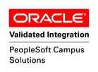
Gideon Taylor Consulting
Gideon Taylor, headquartered in Pleasant Grove, Utah, is a PeopleSoft custom solutions provider for business, education, and government organizations.
Our MISSION is to revolutionize business processes through innovative automation strategies, integration and custom development expertise, and electronic forms technology.
Our VISION is to help our clients work simply, effectively, efficiently, and flexibly.
Founded in 2001 by Paul Taylor,
Original creator of GT eForms™ and ePAF™

Slide 4
Experts in PeopleSoft Automation
GT eForms™
Guided Self-Service
PeopleSoft Forms and Approval Builder
Manager/Employee Self-Service
Custom Development with Approval Framework
Notes:
As specialists in custom business process automation in PeopleSoft, Gideon Taylor recognizes that each client’s requirements are unique. The approach and tools used to automate those requirements should reflect that. We employ a best-of-breed approach to custom automation that can encompass a variety of tools, including delivered PeopleSoft self-service solutions, custom application development, form-building tools, and Gideon Taylor’s GT eForms™ for PeopleSoft.

Slide 5




















Some of our clients…
Some of our clients…

Slide 6

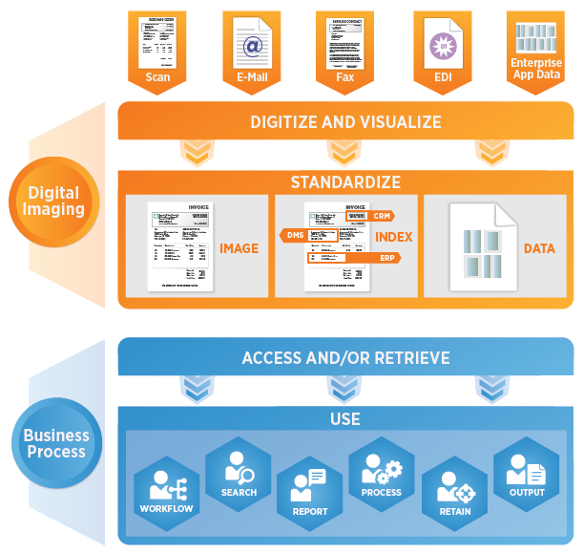
About Canon Information & Imaging Solutions
Canon USA established in 1969
  America’s Headquarters in Melville, NY
  As a technology innovator, Canon Inc. ranked third in U.S. patents registered in 2016 (with 3,665 patents filed)
Canon Information & Imaging Solutions
  A wholly owned subsidiary of Canon, Inc. established
  in 2011
  CIIS brings together Canon’s best-in class imaging technology and information management expertise to deliver value-added solutions.
2017 Institute of Finance & Management Game Changer Award Winner
Solving Business Problems Today by Delivering Future Focused Solutions
Notes:
Lisa
CIIS was created in 2011 to bring to market solutions that leverage the new imaging technologies, as well as Canon’s strong experience in Business Process Automation and Document Solutions. We provide research and development, add in our technology and a customer focused delivery process, which leads us to not just developing innovative solutions, but value-added, future focused solutions.
CIIS capabilities focus around 3 general areas:
- Solutions
- Professional Services
Software.
This new award program recognizes the top 5 companies with solutions that provide value to our profession. The Game Changer Awards showcase companies that provide the most productive and effective technologies and meet the highest standards of design, ease-of-use and conformance with appropriate accounting standards.

Slide 7
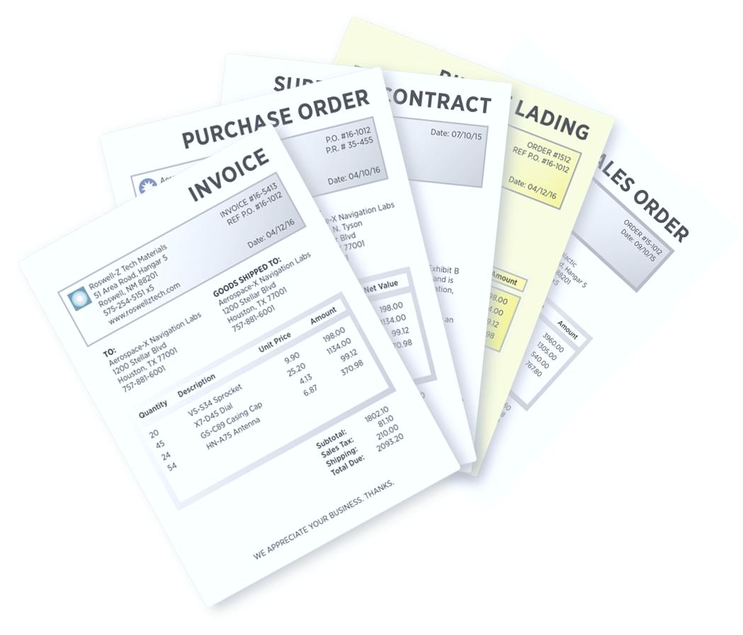
The Problem with Manual, Paper-Based Processes
Essential data is not captured
Data is poorly organized
Data is not timely
Systems are not well integrated
Difficult to track the status of authorization
Higher costs
More exceptions
Longer cycles
Lots of departmental inquiries
Compliance risks
Harder to implement best-in-class processes

Slide 8




Breaking Down Information Silos
Student
Finance
Human Resources
Customer Service
Executive Management
Sales
Purchasing
Departments are now focused on working collaboratively
  Many stakeholders, using different systems
  Information coming from the same documents
Maximize Budgets/Working Capital
Finance
Improve Workforce Productivity
Human Resources
Relationship Management
Procurement
Increase Performance/Retention
Student
Notes:
Through digitization AP departments are transforming from cost centers to value-added strategy centers where the CFO’s role is expanding to performance management of internal operations and external strategy making accurate and real-time data a priority.
AP remains at the core of many processes and is the key to unlocking cross-functional value. Other departments rely on information or supporting functions provided by AP that previously remained locked or fragmented due to department silos and technology limitations.
Technology innovations have allowed for organizations to begin to break down these walls, but without AP Automation many benefits cannot be fully realized. For many organizations AP Automation projects have become not an if, but a when.

Slide 9
Automation is the Answer
Helping Solve Paper, Processing, and Management Challenges
Intelligent document capture
Configurable workflows
Contextual tools for exceptions resolution
Scalable & adaptable for growing organizations
Transparent process – with visibility to process-related documents, status, and mobile access
Seamless – with multi-channel document capture and ERP integration
Document collaboration across ERP and non-ERP users
Optimized processes with efficient resource utilization and process accuracy

Slide 10
As percentage of automation goes UP…
…these go DOWN
Time to task completion
    Amount of effort
    Number of errors
    Calls to the help desk
    Operating costs
    Amount of training
    Documentation
0%
100%
Percentage automation of a business process

Slide 11
Gideon Taylor and Canon Partnership
Unleashing the Power of GT eForms and Canon’s Enterprise Imaging Platform

Slide 12
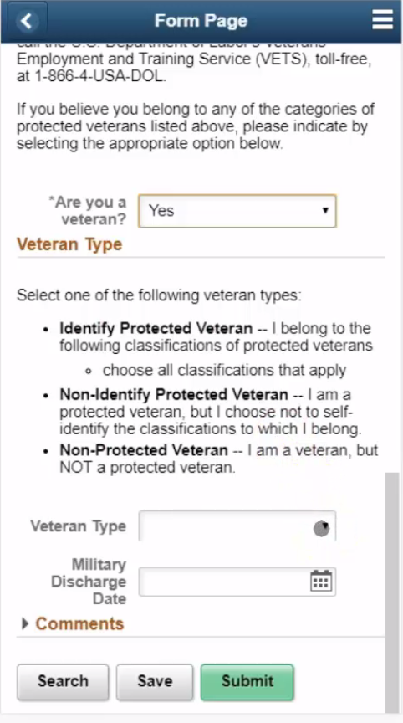
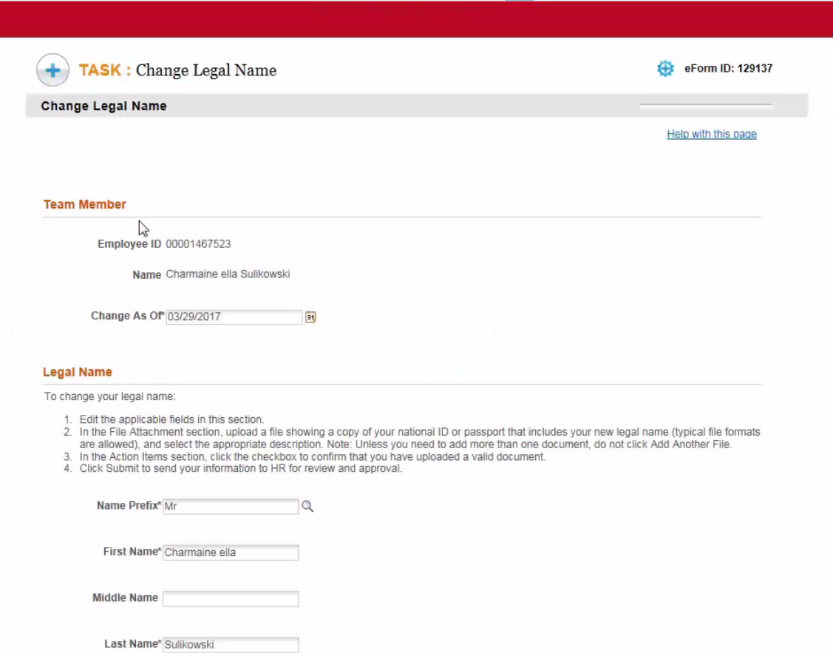
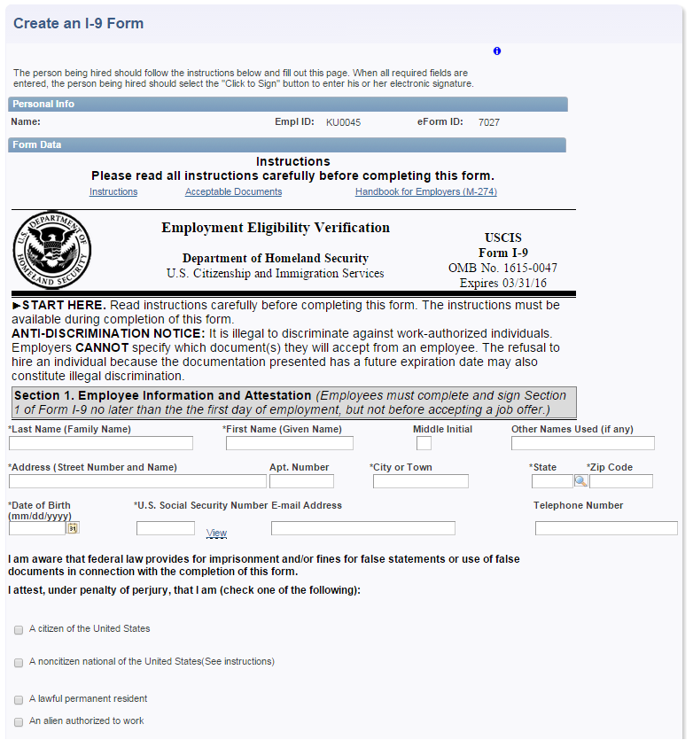
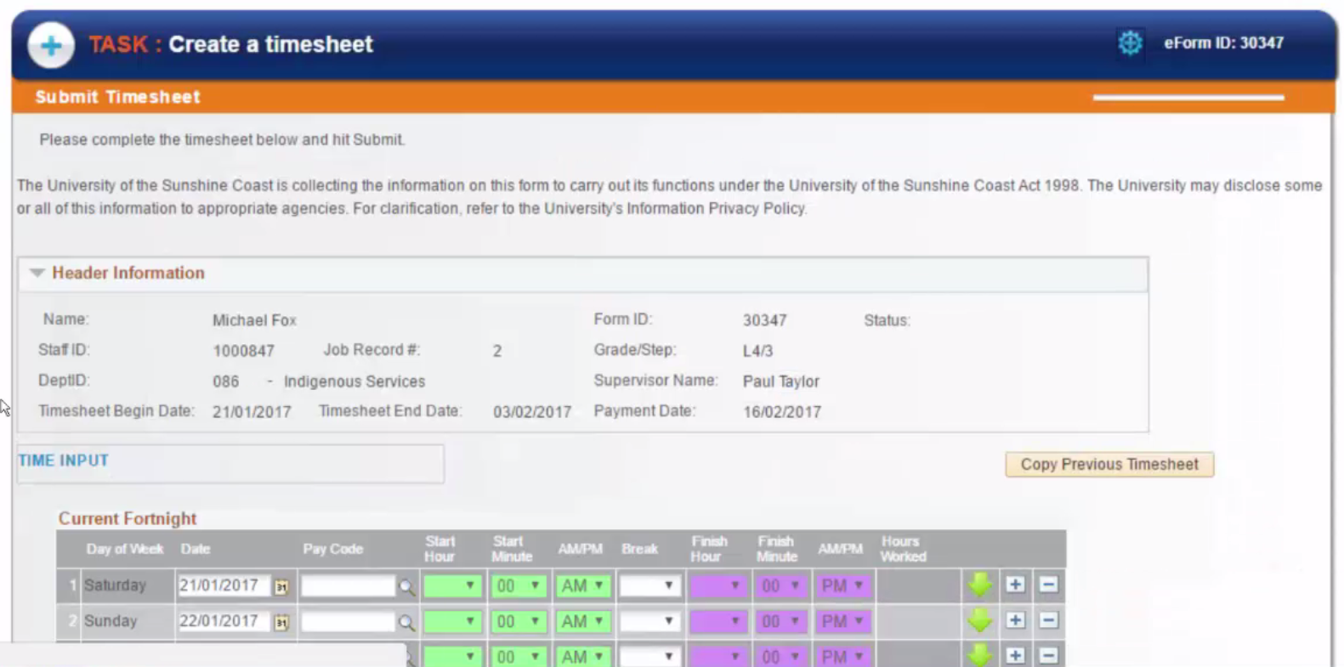
What is GT eForms™?
GT eForms™ – Bolt-on workflow framework and toolset for PeopleSoft. Easily create and manage:
  Custom Self-Service Applications and Electronic Forms
  Workflow, Notifications, Approvals and Electronic Signatures
  Service-Oriented Architecture (SOA) Integrations

Slide 13

GT eForms™ – Unlimited Flexibility
Bolt-on workflow framework and toolset for PeopleSoft
Built 100% in PeopleTools – Familiar toolset for your development team
Native, real-time access to PeopleSoft data, including employee, student, and financial data – no external interfaces to maintain!
  Leverage existing PeopleSoft workflow, security and infrastructure
Configuration-based form creation and management with setup tables to control business logic, form actions and routing
Easy query, reporting and analytic capabilities
Unlimited flexibility in presentation, pageflow, workflow, and routings

Slide 14
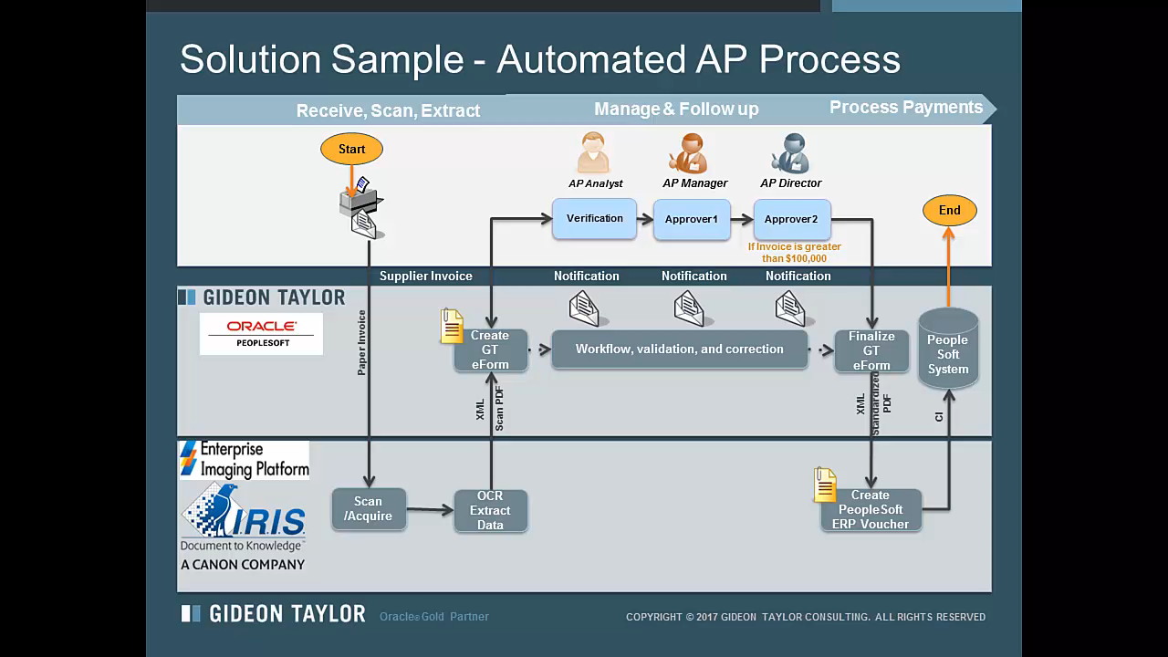
Solution Demonstration

Slide 15

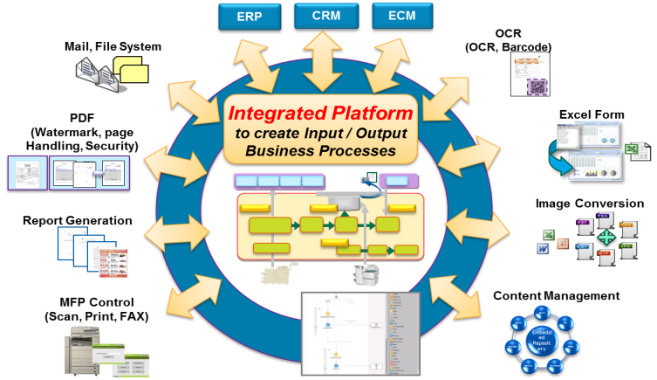

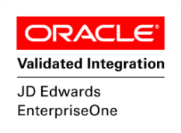
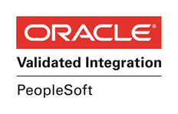
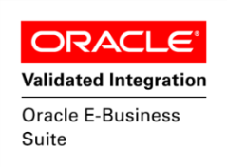
Canon’s Enterprise Imaging Platform
A Single Platform for all your Document-Intensive Processes
Mobile Devices
Notes:
Implementing Canon’s solution will provide you with a platform to then digitize additional processes leveraging the same licenses. Our solution is scalable and adaptable to your organization’s needs and can be suited to fit the needs of larger growing organizations
Reduced time to process invoices
From weeks to just days
Near real-time invoice status visibility
Capitalize on early payment discounts
Improved accuracy
Efficient use of manpower
Increased business intelligence
Info from the document is visible to various stakeholders
Reduced paper storage and printing costs
Low cost integration, scalability and flexibility Improved: efficiency, collaboration, accuracy, business intelligence

Slide 16







Solution Sample - Automated AP Process
Receive, Scan, Extract
Manage & Follow up
Process Payments
Start
AP Analyst
AP Manager
AP Director
Verification
Approver 1
Approver 2
End
If Invoice is greater than $100,000
Supplier Invoice
Notification
Notification
Notification
PeopleSoft System
Paper Invoice
Create GT eForm
Workflow, validation, and correction
Finalize GT eForm
Standardized PDF
XML
XML
Scan PDF
CI
Scan /Acquire
OCR Extract Data
Create PeopleSoft ERP Voucher

Slide 17
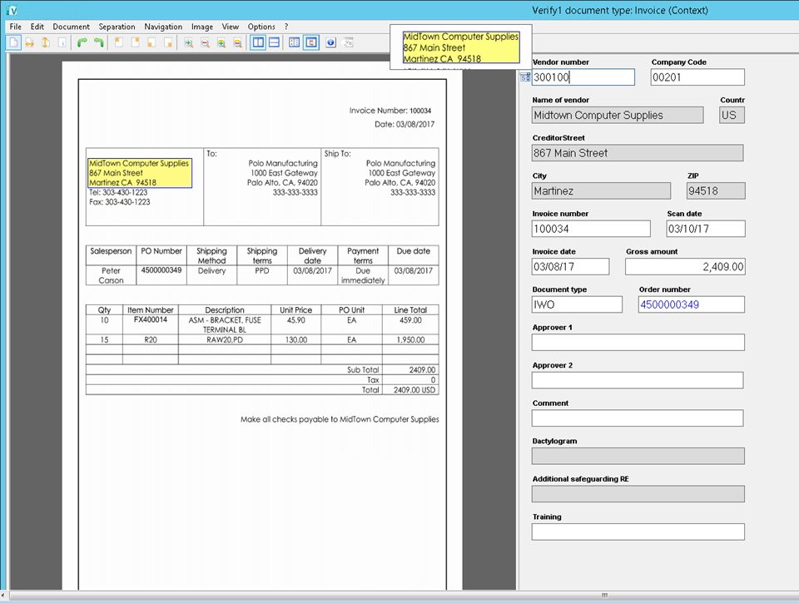

Receive- Scan- Extract - Verify
Scan Paper Documents OR Receive by Email
EXTRACT and VERIFY!
Notes:
Joe - Methods – Hot Folders, Emails, Paper, Device Agnostic
1: Invoice
In the case of a document received as a hard copy, it is scanned and here is the resulting image of the invoice. Our solution is hardware agnostic and works with any make of scanner that offers the required resolution.
In the case of a document received electronically or as email attachment , it is handled directly by the system by fetching the document from one or multiple email address.

Slide 18
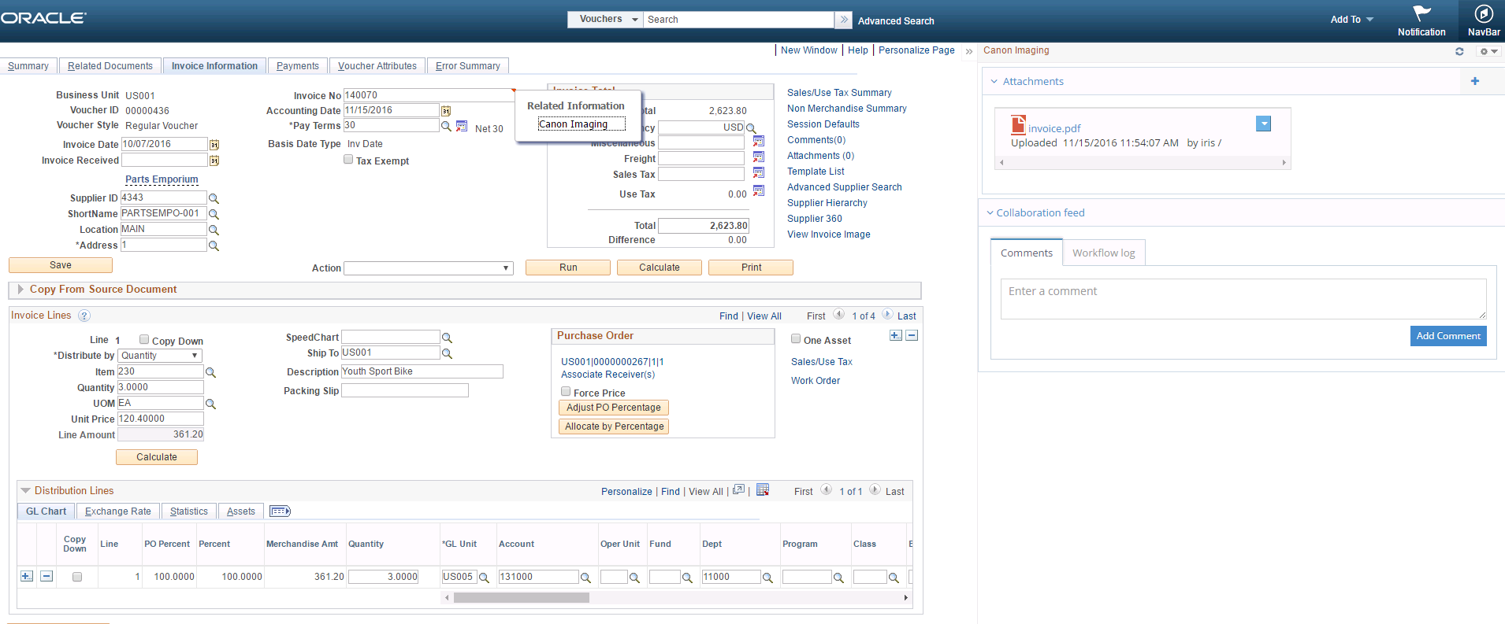
PeopleSoft Split Screen
Document Management Features
  Add related content
  Check out/ Check in, Version Control
  Share via email
  Download content
  Search repository

Slide 19
Solution Sample - Automated AP Process
Receive, Scan, Extract
Manage & Follow up
Process Payments
Start
AP Analyst
AP Manager
AP Director
Verification
Approver 1
Approver 2
End
If Invoice is greater than $100,000
Supplier Invoice
Notification
Notification
Notification
PeopleSoft System
Paper Invoice
Create GT eForm
Workflow, validation, and correction
Finalize GT eForm
Standardized PDF
XML
XML
Scan PDF
CI
Scan /Acquire
OCR Extract Data
Create PeopleSoft ERP Voucher

Slide 20

Growing Hospitality Company
Profile
  Looking to improve user adoption across divisions
  Growing regional company in the Hospitality industry
  7,000 Employees with nearly $500 Million in Revenue
  Over 15,000 invoices a month, from over 20,000 vendors
Challenges
  Lack of visibility into the AP process.
  Multiple divisions throughout the country, not based on PO system
  Inability to accurately and timely close books.
Goals
  Accurate working capital data
  Improved compliance and audit trail
  Committed Oracle PeopleSoft user – requires a deep integration of the AP process with PeopleSoft
Notes:
The project champion, director of shared services, had focused in on AP Automation as a key means to improve their agility.
Due to inefficiencies this company was experiencing a lag in their ability to accurately and timely close the books for monthly, quarterly, and year-end reporting. This affected their ability to generate accurate reports regarding working capital and outstanding payments. The project champion was determined to select a solution with the right functionality to support continued growth and control costs.
The company had thoroughly explored the functionality and goals of their automation project. In addition to visibility across the financial process they were looking for an automation solution that would also support their compliance requirement

Slide 21
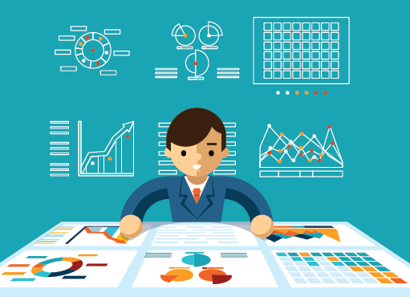
Growing Hospitality Company
Solution
  AP automation integrated with PeopleSoft and industry-specific system.
Business Benefits
  Access to accurate and reliable information on the status of invoices and transactions – to enable fast decision-making.
  Standardized process to enable transparency and compliance.
Notes:
The company had thoroughly explored the functionality and goals of their automation project. In addition to visibility across the financial process they were looking for an automation solution that would also support SOX compliance. CIIS supports this goals through easy to configure workflows and approvals ensuring segregation of duties and a clearly documented audit trail.
On the technology side they were looking for a system that could not only integrate with PeopleSoft, but with their specialty system, while handling numerous invoice channels and 3rd party scanning. Canon’s Oracle validated integration with PeopleSoft was a differentiator, ensuring quality of data and seamlessness of information.

Slide 22

Benefits of Canon’s Solution
Accessibility and Accuracy
  Reliable info, easy to access even from mobile devices
  Business intelligence for various stakeholders
  Integrate with numerous systems for information availability
Business Process Improvement
  Standardize processes and reduce costs
  Improve departmental relations
Flexibility and Scalability
  Support business growth and company expansion
  Department transforms to become a strategic resource
  Utilize our content repository or yours
Notes:
The best AP Solutions will not only support your current needs, but future needs….
Beyond the efficiency gains and savings that may be a widely known benefit of automation, there is an entirely new level of business intelligence that can be gained as a result of the information flow being visible, accessible and reliable.
Visibility into invoices and payables – not only for the AP departments, but also for Procurement, Planning, Customer Services, Sales, and other corporate stakeholders, allows them to make timely and accurate decisions.
Enabled by the visibility is the real time spend analysis, which can help in sourcing, “what if scenarios”, supplier consolidation or diversifications, improved contractual compliance, risk mitigation, fraud detections
As a result, AP departments and AP functions can evolve, as they are no longer perceived as a “cost center” and they start to have a more strategic role, bringing real value add to their companies.

Slide 23

Impact of Gideon Taylor Solutions for PeopleSoft
Xcel Energy
  Consolidated 41 separate forms and processes into 3 intelligent eForms
  Turnaround time reduced from 5 days to 30 minutes
  Reduced errors and manual intervention from 45% to 1%
State of Tennessee
  Consolidated 89 separate personnel actions into 1 dynamic eForm
  700% increase in throughput
  Eliminated hundreds of thousands of paper forms each year
University of Florida
  Reduced administrative transactional workload by 75%
  Errors reduced from 68% to less than 1%
  Realized cost savings of over $300,000 year-over-year

Slide 24

GT eForms + Canon Enterprise Imaging:
Bringing it all together
Automatically generate dynamic PeopleSoft forms from digitized pages
Validate OCR-extracted data against PeopleSoft edits and valid values
Leverage existing PeopleSoft security for workflow routing
Enterprise-level indexing, search, and storage for completed PeopleSoft forms and attachments
Seamless process flow across Enterprise Imaging and PeopleSoft-based eForms
Notes:
The best AP Solutions will not only support your current needs, but future needs….
Beyond the efficiency gains and savings that may be a widely known benefit of automation, there is an entirely new level of business intelligence that can be gained as a result of the information flow being visible, accessible and reliable.
Visibility into invoices and payables – not only for the AP departments, but also for Procurement, Planning, Customer Services, Sales, and other corporate stakeholders, allows them to make timely and accurate decisions.
Enabled by the visibility is the real time spend analysis, which can help in sourcing, “what if scenarios”, supplier consolidation or diversifications, improved contractual compliance, risk mitigation, fraud detections
As a result, AP departments and AP functions can evolve, as they are no longer perceived as a “cost center” and they start to have a more strategic role, bringing real value add to their companies.

Slide 25
Scott Antin
VP Business Development
| Office 651-207-6599
| Cell 651-271-3827
scott@gideontaylor.com
www.gideontaylor.com

