Slide 1
Down the Rabbit Hole: Electronic Forms and Business Process Automation
AZ CUPA-HR Conference July 12, 2022

Slide 2
GT eForms™ - Validated PeopleSoft Automation Solution
Robotic Process Automation
AI Digital Assistants
Process Optimization Analysis
PeopleSoft Project Services
PeopleSoft ‘Keep Current’ Services
Full-Stack Cloud Managed Services
Automation Centers of Excellence
Integrated / Automated Testing – PeopleSoft and Beyond
Build Grow Serve
Delivering on the Promise of PeopleSoft
Helping clients envision and create custom solutions for PeopleSoft using eForms and workflow technology, OCI cloud hosting, UiPath RPA, always-current managed services, full-service consulting and staffing, UX and conversational AI.
Founded in 2001, based in American Fork, UT
Gideon Taylor is a PeopleSoft custom solutions provider for business, education, and government organizations

Slide 3
Some Of Our Clients…

Slide 4
What are we going to talk about this morning?
Business process automation projects are often done to simplify complex processes
Choosing the right tool or technology is only one piece
Complexity can come from any of the other pieces:
Deciding and maintaining scope
Analysis and Design
Implementation Goals and Communication
What are some of the rabbit holes and how can we best avoid them?

Slide 5
700% efficiency increase - State of Tennessee is now able to process as many benefits enrolment forms in one hour as they used to do in an entire day
Reduced turnaround time for personnel actions from 5 days to less than 30 minutes – from submission through final updates to PeopleSoft (Xcel Energy)
75% decrease in total human effort associated with forms processing (University of Florida)
Transformative Results
Manual intervention and error rates on personnel action requests dropped from 45% to less than 1% (Xcel Energy)
A reduction of more than 93% in time required to prep and facilitate employee onboarding processes (Questar Corporation)
Over 10,000 job change actions processed each week without manual intervention or error (ShopRite Stores)
ROI of more than $300,000 year-on-year (University of Florida)

Slide 6
“We just need a simple electronic form…”
….hmmm, but if the manager is out it needs to route to the delegate…
…of course, if it’s over $5,000…
… and we just need to have their manager approve it…
…oh, and did we talk about nominating teams?
…unless the award amount is over $1,000…
“All we want to be able to do is have any employee nominate a co-worker for a bonus award. We need to have them enter who they’re nominating, why they’re nominating them, and the amount they’re nominating them for.”
…and then if we could have it update the system on the backend and add the pay once it’s been approved…
…oh, and I guess that all of them need to be reviewed by the divisional HR approver…
…and we do need to make sure it’s routing to the appropriate managers based on our organization…

Slide 7
What are the Goals of Automation?
Simple
Effective
Efficient
Flexible
Notes:
Simple - Clean, elegant forms. Uncluttered pages and processes.
Effective - Help a user complete a goal/task without being side-tracked.
Efficient - Help users accomplish their goal with as little time, resources, and effort as possible. Cut out the fat that makes a process sluggish and inefficient.
Flexible - Make the form as flexible as possible, which is generally aimed at being able to absorb future changes. (functionally maintained setup tables!)

Slide 8
Indicators for an eForms-based Solution
High transaction volume
Existing process is paper-based
Complex rules for field entry and appropriate valid values
High error rate
Casual user base
Needs signatures
Workflow/approval process
Store form/transaction data in searchable format
Need to trigger email or worklist notifications
Fluid business process – needs Business Analyst-level maintenance
Need to interface with/combine data from multiple systems
Data gets entered into PeopleSoft or other system
Need for audit trail
Need to keep supporting documents together (tie imaged/desktop documents to electronic record)
Need to trigger workflow routings from delivered components without customizations

Slide 9
Business Process Metrics
Average number of forms processed per month or per year
Average amount of time to process each form (from inception through the final data entry and disposal or filing of the paper form)
NOTE: Consider who is involved in that process and the value of their time
Average turnaround time for each form (What benefits would your school see if you reduced your turnaround time by 50 or 75%?)
Average number of errors per form (Univ of Florida dropped their error rates from 68% to less than 1% after automating personnel actions)

Slide 10
Calculating the Cost of the Status Quo
ROLE | (A) INDICATIVE ANNUAL SALARY | (B) TASK(S) IN EXCECUTING PAPER PERSONNEL ACTIONS | (C) ESTIMATED HRS/MINUTES | (D) AVERAGE COST
Department Manager/Department Admin (initiator) |  | Complete the paper form. If action other than ‘hire’, research current data to complete the form. Gather all supporting documents, Determine who needs to sign | 45 min (avg)
Dept Approver (repeat if multiple levels of Dept approval) |  | Review and approve then determine who to route to next | 15 min
Budget Approver (repeat if multiple levels of Dept approval) |  | Review and approve then determine who to route to next | 15 min
Division/Dean approval (repeat if multiple levels of Dept approval) |  | Review and approve then determine who to route to next | 15 min
HR/Payroll |  | Review to ensure data is correct and the appropriate authorities have approved. Work with initiator to fix errors. Input into PeopleSoft and validate input. | 30 min (avg)

Slide 11
Discovery
Explore the full business process
SMEs who are directly involved
Understand the ‘why’ behind each step
Cover all touch-points (triggers, outputs, routing, exceptions, etc.)
ODA – Optimization and Defaulting Analysis
Field-level analysis of data sources and destination fields
Identify or create relationships between data to eliminate fields, restrict values, create edits, etc.
Rough design and/or prototype
Notes:
Examine and understand the business process – we have multiple conversations with the main groups/individuals who are involved with the process. We do this by:
going over where the process can start
Understanding the routing – who, when, and what?
What supporting processes or documents are needed?
ODA
Eliminate fields, default values, restrict values, create edits, etc.
Queries and other live data to support this – as much live data as possible
Including those who understand the process is still so important here.

Slide 12
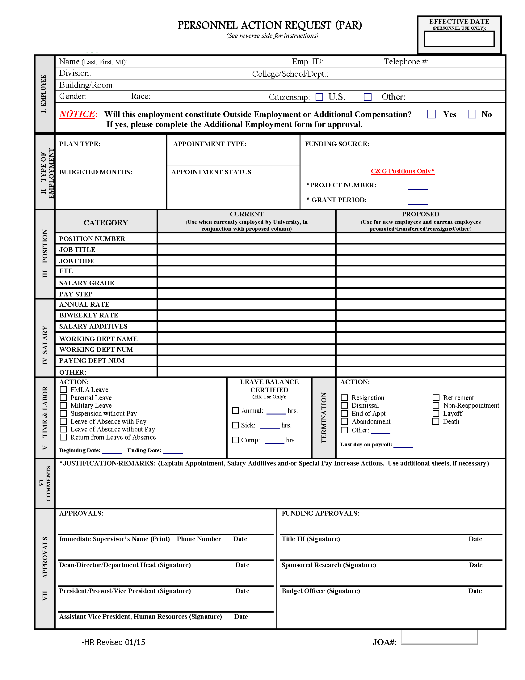
Sample Personnel Action Form

Slide 13
Create a Project Vision
A Project Vision guides the team, especially when complexities are introduced
Recruit/engage a strong executive sponsor (THIS CANNOT BE EMPHASIZED MORE!)
Clearly define the limits: budget, time, scope
Understand which factor is most important – this helps when requirements start to get bulky
Define the goals – When will it be “successful”?
Notes:
Deciding and maintaining scope.

Slide 14
Automation Project Development Effort
Automate
Re-Host
10%
Simplify
Workflow

Slide 15
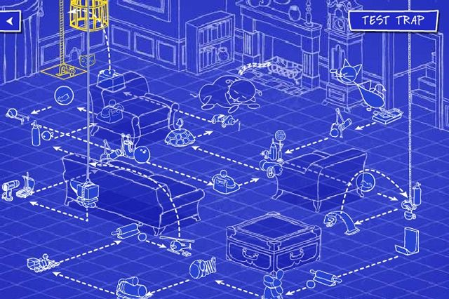
Analysis and Design
Expect the simplest of forms to have its share of complexities to work through
Use the Project Vision to guide difficult decisions
Employ principles to keep the form SEEF-ful
Keep an eye out for common complexities

Slide 16
Vision Principles
Hide the Complexity
Get the Logic out of heads…off paper…and into code or config; setup tables
Pinpoint repetitive or labor-intensive tasks
Focus on User Experience
Minimalist, guided and naturally unfolding
Only show valid fields and values
Don’t ask users to leave a field BLANK
Focus on task completion
Trust the Solution
Focus on the Bulk of the Transactions
Notes:
My old notes on principles below.
The Vision Principles (aka The Big 12) - concepts that we apply to reach our Vision Objectives (SEEF!) (Though most of these tend to support two or more aspects of SEEF, the description of each of them below has at least one objective noted.)
1) Focus on the user experience
That can be hard because our projects are staffed with core office users (instead of end users) and they tend to focus on making their own jobs easier. But our vision goal is to simplify the process for the end user; to make the form effective for them.
2) Minimalist design
Again - simple, clean, and elegant. We don't want a bunch of stuff on the page to confuse the eyes/users. 3) Guided step-by-step process
In order for our forms to be simple for the users and efficient with their time, we need to guide the users. A page full of blank fields that beg to be filled will overwhelm them. Instead, we aim to guide them through fields and reveal relevant questions and pages only when appropriate.
4) Functionally empowering
By allowing Business Analysts to manage the solution (through clever use of tools like our setup tables and Admin page,) we are giving our clients solutions that will give them the flexibility to adapt to inevitable changes that will come in the future. 5) Optimal to least-optimal storage of business processes
The best place to store business process logic is in a setup table.
If that isn't practical in a given situation, then the next-best place to store business process logic is in the code. The worst place for business processes is a user's head! (Not all users will understand the processes the same way. Humans are forgetful! There are so many other reasons why this is not simple, effective, nor efficient!)
6) Automate repetitive and labor intensive tasks
Some of the biggest gains in efficiency come from being able to remove repetition of tasks/data and to ease the effort needed to accomplish goals/tasks. 7) Take away bad choices
A form is far more simple and quick (efficient) for a user if "bad" choices are not even seen. Why should they waste time trying to choose between a lot of values that are invalid? That's why we like to restrict users to valid values and fields. 8) Shift the focus from details to task completion
In order for a form to be effective in getting the user to their goal, we can't distract them. The big picture is accomplishing their goal. Throwing in extra steps/questions that don't have a role in getting them to their goal is a waste of their time and patience and lends to a clunky and difficult form. 9) Trust the solution
Adding a bunch of "display only" fields just so someone can verify that the form handling the data correctly is a tactic born from mistrust and it junks up a form and drives us away from simplicity and efficiency. While it's understandable that the client wants to make sure the form will work correctly, that is what the TESTING phase is for! They not only need to trust that the data is being handled, but they also need to realize that old problems and heartaches (fears!) are generally resolved simply by having a faster and more efficient process in place. 10) Hide the complexity
"Complex" is the opposite of "simple". This seems obvious, but it's rather easy for complexity to find its way in to a form; especially when triggered by fear of legacy problems, fear of a new system, compulsion to code for exceptions, and the desire for bells and whistles (gold-plating!)
Our designs aim to hide complexity by removing what is unnecessary and pushing business processes behind the scenes (in setup tables first and code second, right?)
11) Focus on the bulk of transactions
We intentionally plan to leave a percentage of transactions un-automated. The last x% (whether that is 15%, 5%, or 3.1415...%) generally constitutes a huge bulk of complexity. It's best to leave a percentage of transactions manual versus making all the rest of the transactions more complex just to handle the few. This supports our goals of efficiency and effectiveness. Each client/process has its own threshold for where the complexity of the few outweighs the effectiveness of the many.
12) Don't make the user leave a field ________.
If a user doesn't need to fill out a field, then we aim to hide that field so that they don't have to sit and ponder what they are supposed to do. It takes just as much effort (or more, generally!) to leave a field blank as it does to fill out a necessary field. Keep it simple for the users!

Slide 17
Factors that add unnecessary complexity
Complexity
Gold Plating
Building for Exceptions
Fears of the New System
Covering Old System’s Problems
Notes:
Simplicity might seem the most negotiable, but it will eventually drag the other objectives down with it.
Start simple and only add what is necessary. Here are some complexities that might come up.

Slide 18
Complexity: Covering Old System’s Problems
Watch out for:
Unnecessary “visual validation” fields
Asking for information that isn’t used
Outdated processes
“We’re not sure who uses that.”
“That’s just how I was taught to do it.”
Some approaches and suggestions:
Question fields and processes to identify those that are no longer useful
Test/revisit processes that the team is unsure about
Cut out debated fields for the prototype and examine during modeling
Covering Old System’s Problems
Notes:
Slide: Complexity: Covering Old System’s Problems
This is a chance to eliminate complexities that are no longer needed – this is why we question everything.
Examples on slide
Some of the ways to address these types of concerns:
Question processes and clean up anything that is clunky and or unnecessary.
Ask the client to test the scenario in their system to ensure there is no longer a need, especially for legacy-system fears
Encourage a simple prototype and be willing to note fields they are “uncomfortable letting go of” in the appendix of the spec for discussion during modeling. This allows them to see the cleaner design first and gives us the ability to talk them through the reason we feel a field is unnecessary during the modeling discussion.
Some upcoming Vision Principles that address this:
Focus on the User Experience
Minimalist Design
Trust the Solution
Hide the Complexity

Slide 19
Complexity: Fears of the New System
Watch out for:
Unnecessary “visual validation” fields
Asking for a bunch of “just in case” fields
Stated mistrust of the system/technology
Some approaches and suggestions:
Use edits in place of extra fields and information
Modeling and testing cycles can help eliminate those worries
Validation reports can go a long way in eliminating complexity on a form
Fears of the New System
Notes:
Slide: Complexity: Fears of the New System
Examples on slide
Some of the ways to address these types of concerns:
Suggest edits to help ease minds (and avoid unnecessary fields and field-control)
Remind the client that they’ll get the chance to test the solution (while also reminding them that they are responsible for giving you the logic for successful transactions!)
Make suggestions that exercise trust while still addressing fears. Validation reports can be run to check on pieces of data. Going live with a cleaner design first, then noting the actual level of difficulty they do/do-not encounter is also a good suggestion and forces them to exercise trust first.
Some upcoming Vision Principles that address this:
Trust the Solution
Hide the Complexity
Automate repetitive and labor intensive tasks

Slide 20
Complexity: Building for Exceptions
Watch out for:
High amount of effort spent on low-use fields/logic
Long discussions around rare scenarios
Conversations that go in circles
Some approaches and suggestions:
The goal is never to cover EVERY SINGLE TRANSACTION
Keep in mind the average user’s experience
Exceptions can be addressed in later phases; after usage analysis
Building for Exceptions
Notes:
Slide: Complexity: Building for Exceptions
Examples on slide
Some of the ways to address these types of concerns:
How often does this really happen? Is it less than our vision’s threshold?
Remember – we are not creating a solution for every single transaction. That is not one of our objectives nor principles.
Get the group to consider an average user’s experience and ensure that is not being spoiled for the sake of rare needs.
Encourage the client to consider some work-arounds.
Some upcoming Vision Principles that address this:
Focus on the user experience
Shift the focus to the big picture (for users – make sure they can get to their goal, not be bogged down by unnecessary details)
Hide the complexity
Focus on the bulk of transactions
Don’t make the user leave a field blank.

Slide 21
Complexity vs Transaction Coverage
4x
Level of Complexity
2x
1x
0%
50%
90%
95%
98%
99.5%
100%
% of Transactions Covered in Solution

Slide 22
Complexity: Gold Plating
Watch out for:
Unnecessary fields and logic
“Can’t we just add this field/function, too?”
Requests for overly-complex logic trees
Clutter, small impacts, and distraction from real goals
Some approaches and suggestions:
Focus on the Project Vision – distractions put that at risk
Move gold-plating features to a post-go-live phase
Keep a visible list of the “nice to haves” so that the group can let them go
Gold Plating
Notes:
Slide: Complexity: Building for Exceptions
Examples on slide
Some of the ways to address these types of concerns:
Review the project vision and the 12 Principles with the group to give it some perspective – gold plating is a distraction from reaching the real goals
Note the suggestions, but mark them as “nice to haves” to be considered in a later phase.
Some upcoming Vision Principles that address this:
Focus on the user experience
Focus on the bulk of transactionsShift the focus to the big picture (for users – make sure they can get to their goal, not be bogged down by unnecessary details)

Slide 23
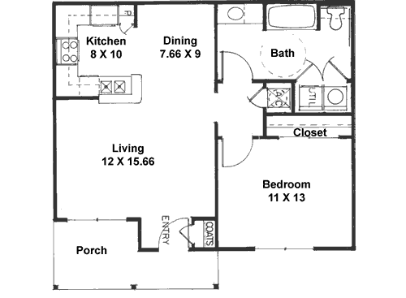
What you think you’re building…

Slide 24
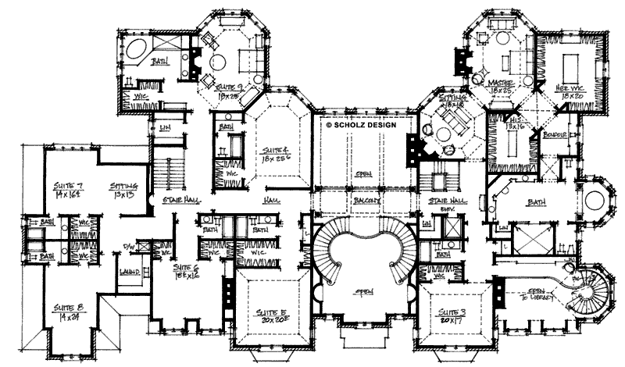
Where your requirements could lead you…

Slide 25
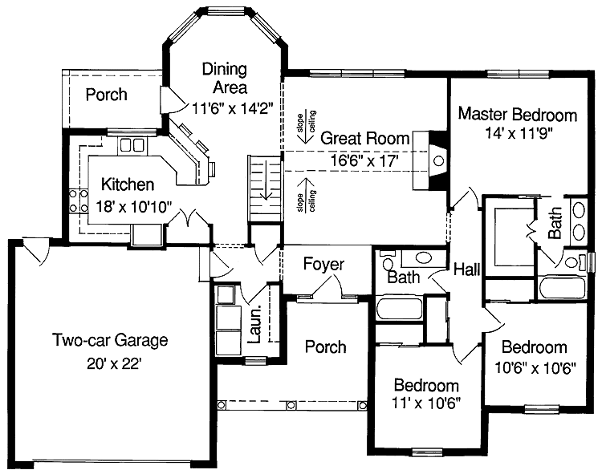
What you should expect to build…

Slide 26
Get it in…get it done…and go live!
Early Go-Live
INCREASES…
Later Go-Live
INCREASES…
ROI
Actionable Intelligence
Product Satisfaction
Risk
Cost
Effort
Resistance
Complexity
Time to Go-Live
Notes:
Sometimes organizations fear going live until they’re confident they’ve met everyone’s requirements. There can be valuable benefits, however, to going live sooner rather than later. Chief among these is avoiding the temptation to try to account for every exception and every little requirement. Get the system live, and then address minor changes as actual demand (and real-world use) requires. When you consider the value that automation alone can bring, some of the ‘demands’ will disappear simply because the process is now automated. You’ll also be able to evaluate the need for specific requirements based on data that can be gathered in production. How frequently do certain exceptions occur? Where are the bottlenecks in the new process? Are there tweaks that can help the new form be more efficient and effective?

Slide 27
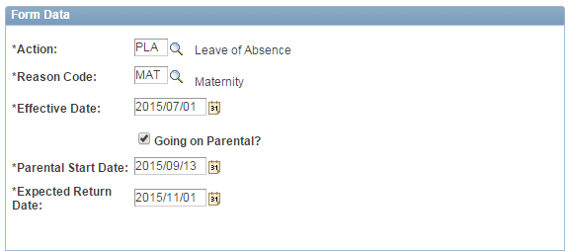
SAMPLE: Design Result – Spec and screenshots
By selecting ‘Leave of Absence’ and ‘Maternity’, specific fields related to parental leave are displayed to the user.
Notes:
Illustrating the underlying requirements and design specifications that generate a simplified user experience.
These images show what happens when a user fills out this status change form with different data – extra fields open up based on logic. The next page shows some of the spec documentation behind this.

Slide 28
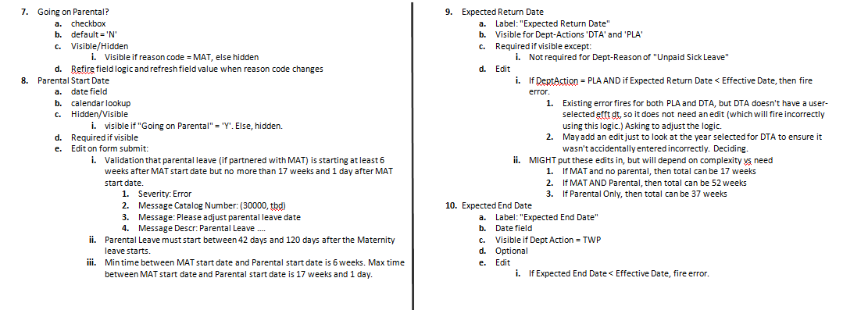
These were our process requirements…
Notes:
This shows a portion of the spec that dealt with the form in the previous slide.

Slide 29
Building Relationships – “Hey, Data, meet Logic!”
(1) Submitter Name
Hire Form
(2) Submitter ID
(3) Employee Name
(15) Standard Hours
(16) Pay Group
(4) Employee ID
(5) Effective Date
(18) Comp Rate
(19) Comp Rate Code
(6) Company
(20) Position #
(7) Business Unit
(8) Dept #
(21) Action
(22) Reason
(9) Location Code
(10) Employee Group
(17) Holiday Schedule
(23) Supervisor Name
(11) Job Code
(12) Reg/Temp
(24) Supervisor ID
(13) Full Time/Part Time
(14) FTE
(25) Supervisor Phone
Notes:
This is an illustrative example of a 25-field Hire form that one of our clients, Kal Tire, had previously designed for their store managers as a SmartHire template in PeopleSoft. When we helped Kal Tire replace this form with a GT eForm, we were able to configure logic within the eForm to take advantage of the relationships between the different data elements…

Slide 30
Now, isn’t that so much easier?
Hire Form
(4) Employee ID
(5) Effective Date
(18) Comp Rate
(20) Position #
(10) Employee Group
Notes:
The result was a reduction of fields from 25 down to only 5 that managers now had to complete to execute a ‘hire’. THAT is an example of powerful efficiency!

Slide 31
GT eForms™ Demonstration
Student Hire eForm:
https://youtu.be/KAmtUe_XgoQ

Slide 32
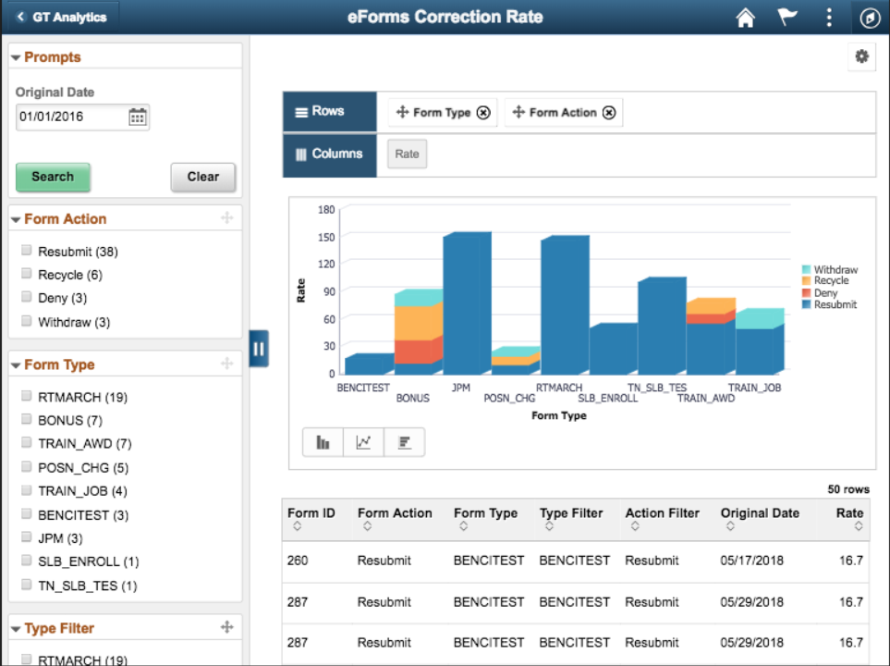
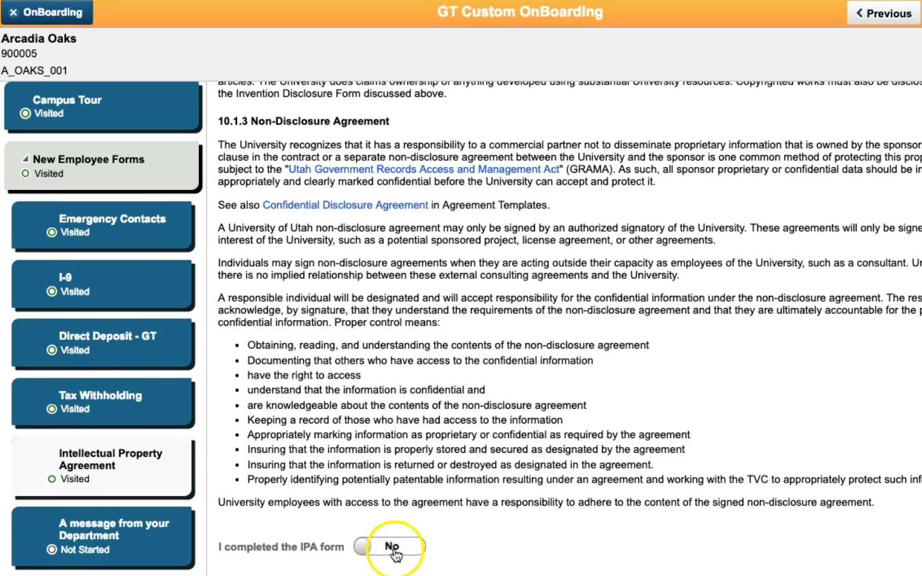
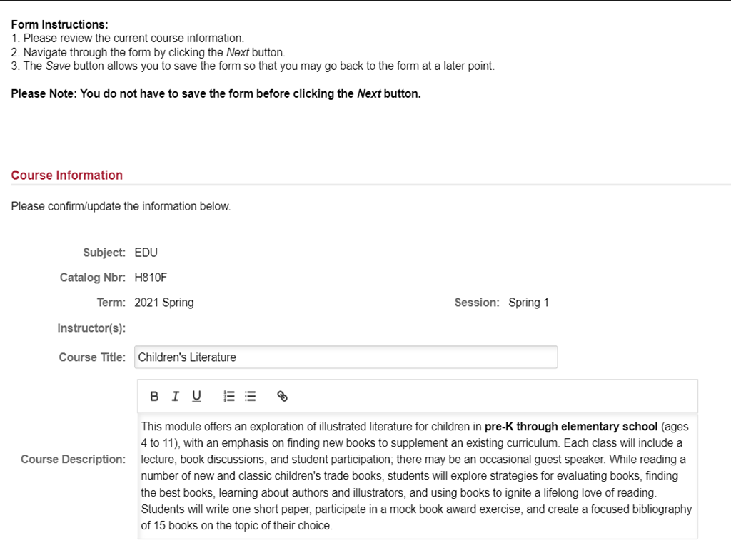
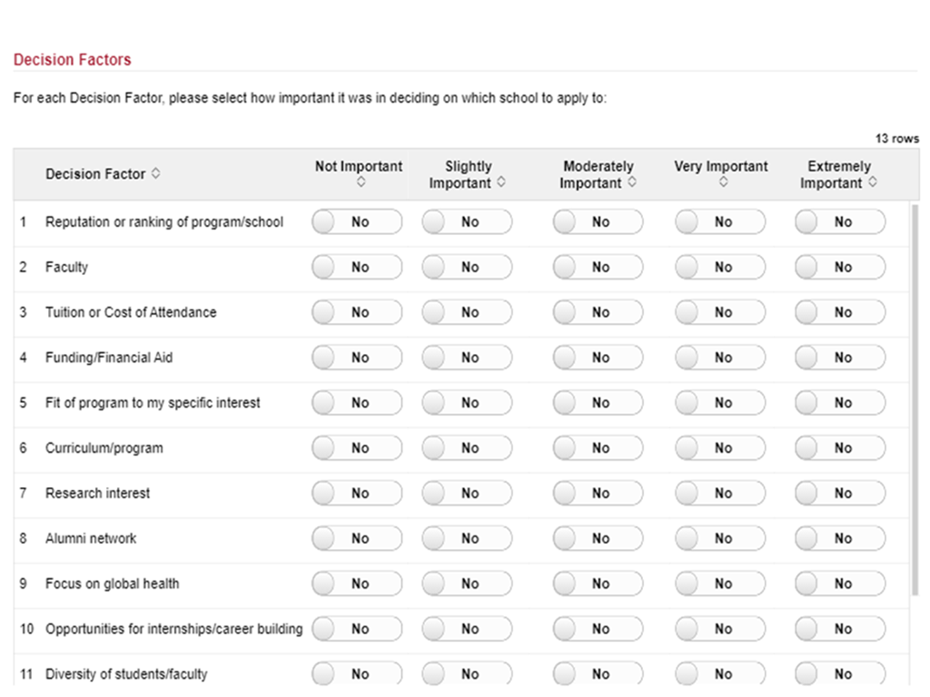
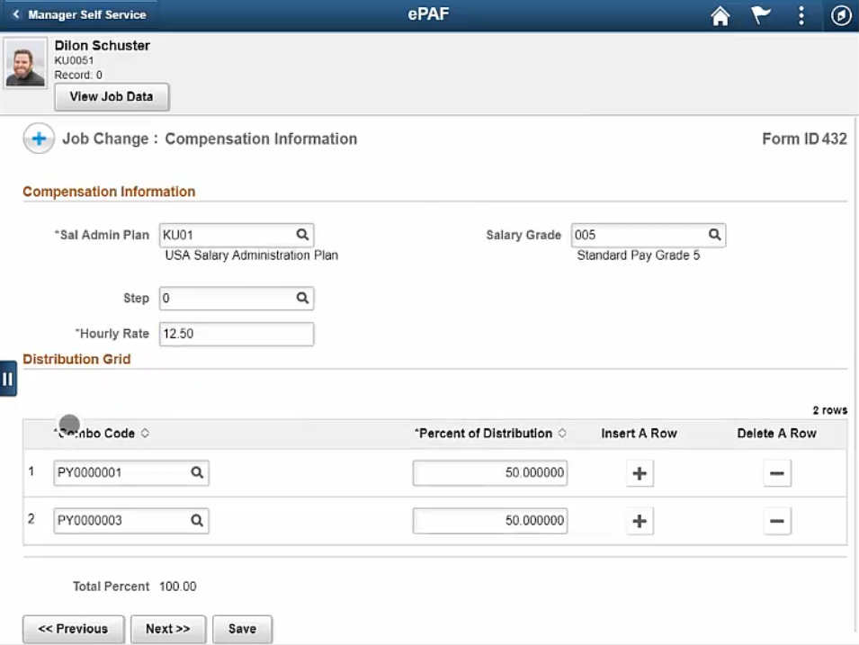
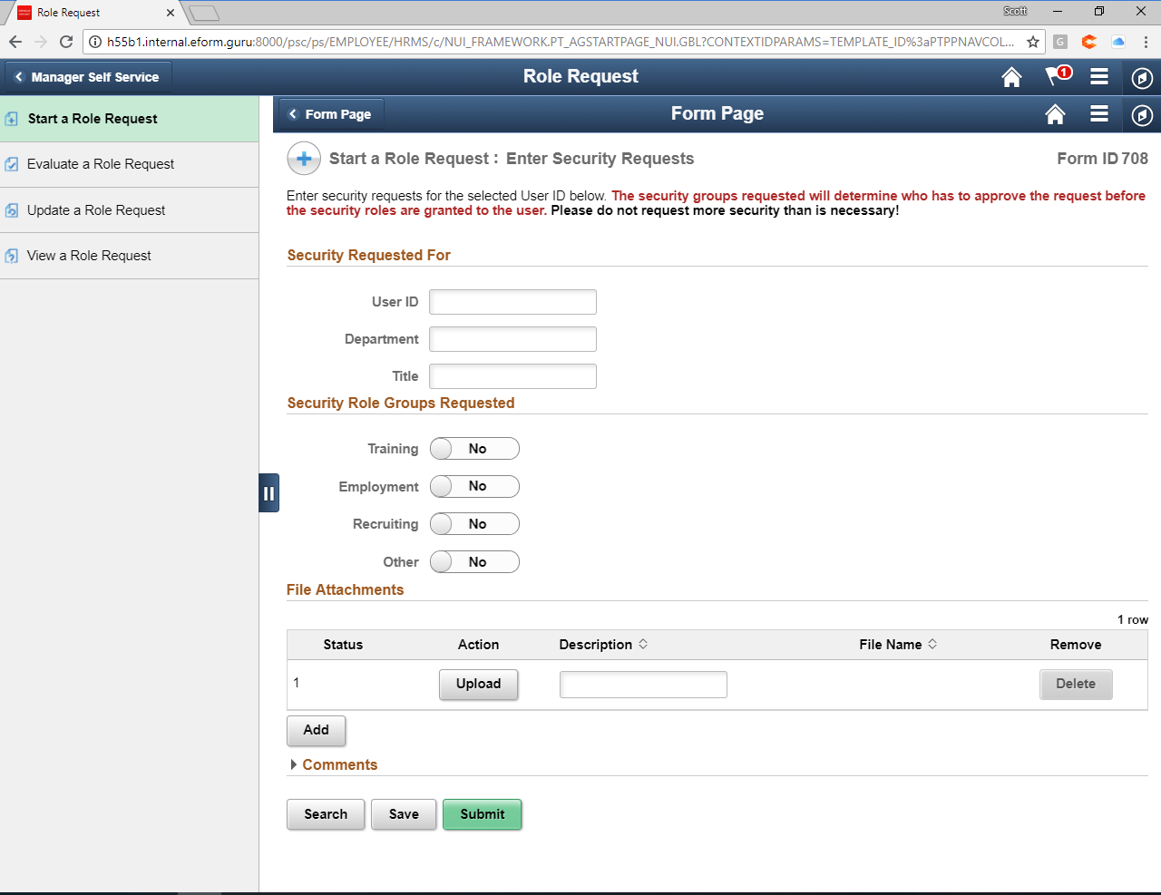
GT eForms™ – Unparalleled Automation
Build Configuration-based Custom Fluid Solutions
Transformative Results
Configuration-based Form creation
Pre-Population
Conditional form behavior
Restricted valid values
Bulk actions
Attachment management
Configurable routing
Full PeopleSoft security
Edits & validations
Reporting & analytics
700% Efficiency Increase
Turnaround reduced from 5 days to 30 minutes
Reduced manual intervention & errors to less than 1%
Saved over 90% of time for new employee onboarding
$
Direct year-on-year ROI over $300,000

Slide 33
Enabling Efficient Design
Empowers those that know the process best
Enables on-the-fly design and modeling
Dramatically reduces solution development time

Slide 34
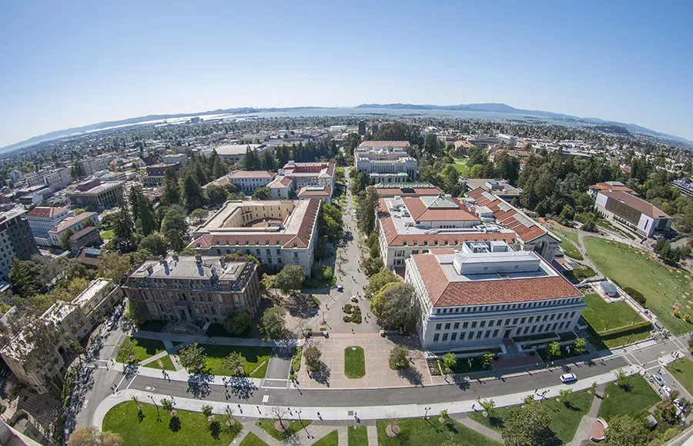
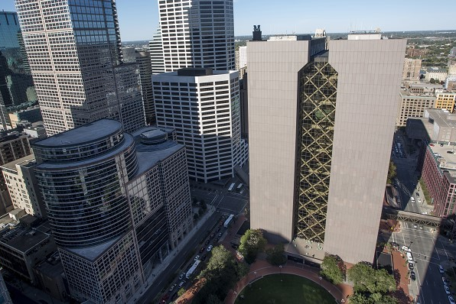
Transforming and Extending the Peoplesoft Experience with GT eForms
UPTAKE NEW PS TECH
INNOVATE
SERVE NEW POPULATIONS
RAPID RESPONSE
Wakefern Food Corporation
University of CA, Berkeley
Hennepin County, MN
Princeton University
HCM 9.2
Dozens of manager and employee eForms
Now Implementing:
PS Total Rewards
PS OnBoarding Activity Guide enhanced with eForms
Campus Solutions 9.2
Dozens of student and faculty eForms
2019 PeopleSoft Innovator Award for rapid Fluid deployment using eForms
HCM and FSCM 9.2
eForms for employee self-service, finance transactions, and regulatory compliance
Now Implementing:
Citizen self-service in PeopleSoft
Vehicle registrations and renewals
Campus Solutions 9.2
Created and launched 16 new eForms in 90 days
COVID-19: Initial dev to Production with two student eForms in less than 24 hours

Slide 35
Robotic Process Automation
Efficient, Error-Free Business Processes
Delivered ROI
Logs into and Navigates through any Application
RPA takes over the mundane, and repetitive work normally performed by people, freeing up humans to focus on more strategic value-added activities
Simulates Human Actions
Enterprise-wide Use Cases
Follows Instructions Never Rests
HCM
Finance & Accounting
Customer Services
Quick to Implement and Powerful to Scale
Fills in Forms Moves Files Reads & Enters Data, Opens & Sends Emails
Supply Chain
IT Services

Slide 36
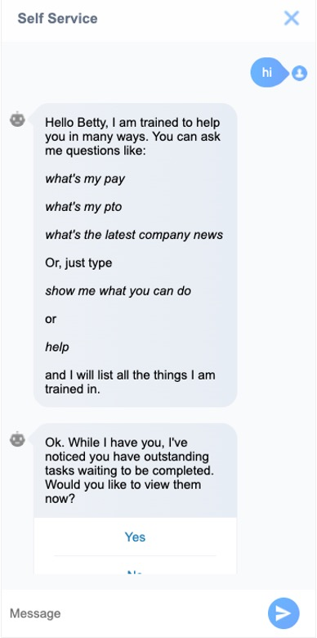
Meet Ida IntraSee’s Digital Assistant
Enterprise-grade digital assistant
Uses machine learning AI
Built on Oracle’s AI and Cloud
Scalable to thousands of questions in over 100 languages
Authenticated and non-authenticated chats
Multi-channel capable (Web, Teams, SMS, etc)
Pre-built catalog of questions/skills/integrations
Integration adapters such as PeopleSoft, HCM Cloud, Microsoft, ITSM, LMS
Add questions, answers and topics
Conversational satisfaction surveys
Role-specific & personalized answers
Alerts, nudging and suggestions
Automated deployment and testing (no expensive staffing/consulting!)
AI that gets smarter over time

Slide 37
Scott Antin VP Business Development
651.207.6599
651.271.3827
scott@gideontaylor.com
www.gideontaylor.com

