Slide 1
ePCR Means EASY Position Change Requests!
Chris Riggs, State of Tennessee
Paul Taylor, Gideon Taylor
July 19, 2018 8am – 9am

Slide 2
Presenters
Chris Riggs
Paul Taylor
Senior HR Business Analyst
State of Tennessee
christopher.riggs@tn.gov
President and CEO
Gideon Taylor Consulting
paul@gideontaylor.com
Chris Riggs has 12 years of state experience, with all 12 of those in implementation and maintenance of various Human Capital Management related Oracle PeopleSoft modules and third-party solutions.
Paul Taylor is the original creator of the GT eForms™ workflow toolkit for PeopleSoft and ePAF™. He has 20 years of PeopleSoft industry experience, and a passionate focus on revolutionizing operational efficiency through business process automation.

Slide 3
State of TN
Employs more than 40,000 staff members in more than 50 agencies across all 3 branches of government
Provides HR and Benefits services for more than 270,000 retirees and non-payroll employees
Serves an estimated 6.6 million citizens every day
Implemented PeopleSoft in September 16, 2008
Currently on PeopleTools 8.56, HCM/ELM/FSCM 9.2.
Oracle Showcase client

Slide 4
Gideon Taylor Consulting & Oracle
Gideon Taylor, headquartered in Pleasant Grove, Utah, is a PeopleSoft custom solutions provider for business, education, and government organizations.
Our MISSION is to revolutionize business processes through innovative automation strategies, integration and custom development expertise, and electronic forms technology.
Our VISION is to help our clients work simply, effectively, efficiently, and flexibly.
Founded in 2001 by Paul Taylor,
Original creator of GT eForms™ and ePAF™

Slide 5
TN focused on achieving greater business efficiencies in many human resources functional areas

Slide 6
Overarching Vision
Implement a standardized procedural framework for optimization of Human Resources
Provide consistent enterprise-wide practices
Empower managers by leveraging automated tools
Streamline the HR transaction process
Increase capacity of agency HR teams to focus on employees rather than transactions

Slide 7
Strategy and Approach
Oracle Insight Initiative
Evaluated climate and customer experience
Identified areas of improvement within HCM application
Compared TN practices and Key Performance Indicators to best-in-class

Slide 8
Oracle Insight Initiative
What We Learned
TN’s large, decentralized HR structure was out of step with industry best practices
TN lacked automation and self-service options
The True Cost
HR staffing levels significantly exceeded median and best-in-class
HR bandwidth consumed by paperwork associated with transactions
Conducting 21st century business with a 20th century approach

Slide 9
TN Response to Findings
Identified areas of opportunity for automation utilizing “eForms”
Increased Self-Service options for Employees and Managers
Streamlined HR structure by implementing a shared services model

Slide 10
Embracing eForms
ePAF – Represented first foray into form automation
Initially greeted with moderate skepticism
Success of ePAF allayed any concerns
ePAF success resulted in TN pursuing additional eForm solutions

Slide 11
eForm Suite Adopted by TN
ePAF – automated all HR transactions involving an employees’ job data
Position actions and corrective actions to job data were excluded
eBAF – automated hiring and benefits selections for our non-payroll population
Retirees, local and higher education and local government employees
AWS – automated Alternative Workplace Solutions authorization forms
Go-live March 27, 2017
Employee Policy Acknowledgements – automated DOHR required policies for employees
Go-live July 14, 2017

Slide 12
Why eForms?
Logic can be built into a form to help reduce errors
Workflow can be customized to level required for each individual business unit
Audit section increases visibility and accountability

Slide 13
Form Logic & Functionality
Form fields default based on types of transactions, reducing data entry errors for all forms
Action/Reason combination derived from data entered on form
Attachment capability and required attachments based on transaction type
Elimination of paper justifications and paper forms
Configurable text and links in forms

Slide 14
Workflow
Configurable notifications, flexible workflow using Ad Hoc approvers
Automatically writes to Position Data once all approvals have been received (except for higher effective dated row which must be manually entered)
Consists of initiators, approvers and reviewers on two levels (business unit and DOHR)
Can be configured to include different workflow requirements

Slide 15
Visibility, Accountability, and Audit
Security-based user view of approval process
Easily identify with whom a document is pending
Easily identify bottlenecks in approval process
Enhances accountability during approval process, providing insight not possible with a paper form

Slide 17
Start a New eForm

Slide 18
Withdraw, Save, or Resubmit

Slide 19
Evaluate as HRO

Slide 20
Evaluate as DOHR and Execute

Slide 21
Recycle as HRO

Slide 22
Established Gains Using ePCR
Decrease in amount of time to approve a transaction
Less errors due to form logic
Comment section for better communication
Decrease in amount of time for a transaction needing correction
Transactions cannot be submitted without required documentation

Slide 23
Established Gains Using ePCR (cont.)
DOHR tracking of productivity of employees
Ease of use
Audit section to increase accountability
Instant knowledge of where a form is located in workflow
Flexibility in numbers of approvers for small and large business units
Replaced inadequate system to meet state needs

Slide 24
ePAF Stats
More than 95,000 forms have been completed since going live June 2015
April 2018: Agencies completed 2,850 transactions with average 4.6 days to approve; DOHR averaged 1.6 days
eBAF Stats
Currently processes a day’s worth of enrollments in an hour
ePCR Stats
More than 3,500 forms completed.
AWS Stats
Since March 2017 nearly 5,000 AWS have been initiated .
AWS is rolling out to other agencies and we expect utilization to climb
Policy Acknowledgement Stats
Since going live in July 2017, more than 7,000 forms have been executed.
April 2018: Agencies completed 626 transactions with average 2.8 days to approve; DOHR averaged 3.3 days
Nearly 35,000 forms have been executed.
Average approval time reduced by as much as 40%, from to just 6.1 days
Reduced mandatory overtime by half during Annual Enrollment
Average approval time reduced by as much as 35% to just 6.2 days

Slide 25
Current/Future Projects
Adding additional workflow to ePCR
Request to add criteria to include Finance and Administration budget office
Business Unit Specific Employee Policy Acknowledgements
Trial run has been completed
Upgrade to Gideon Taylor 3.1 platform
Configuration-based form creation
First wave of business units to begin in August 2018
Enable greater business analyst involvement in creating new forms

Slide 26
Preview of GT eForms 3.1
Fluid! Fresh, mobile user interface – any device, anytime, anywhere
Configuration-based form creation and management with setup tables to control business logic, form actions and routing
Form Engine – Page, segment and field creation; form layout; field attributes and behavior (e.g. display-only, required); embedded instructional text, links and graphics
Logic Engine – Configure form logic to meet complex business process requirements, including conditional field and page display, auto-population, restricted valid values, conditional workflow and more
Workflow Engine – Configurable routing with native integration with delivered PeopleSoft Approval Framework (AWE)

Slide 27
What are the Goals of Automation?
Simple
Effective
Efficient
Flexible

Slide 28
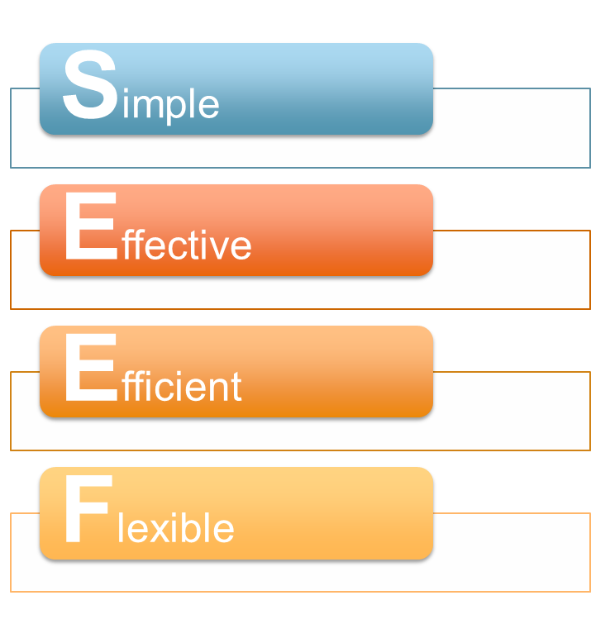
Hiding Business Process Complexity
Simple
Effective
Efficient
Flexible
Notes:
A complex business process doesn’t have to appear complex to the users who participate in it. It takes a lot of thought and work, however, to effectively hide that complexity, creating a process that requires little of its users, yet still handles all the complex requirements of the business process.

Slide 29
Hiding Business Process Complexity
Notes:
Hiding the complexity of a business process from its participants is like burying a pyramid in sand. The more you want to hide, the more work it is going to be.

Slide 30
Hiding Business Process Complexity
Notes:
There is a trade-off to be made and a balance to be struck between the project investment and the user experience. Every inch higher on the pyramid requires more sand to bury than the inch before it. You only pay for the project once, though, while you reap savings from a simple user experience over and over. If you’re training and paying lots of users to climb a pyramid every day, this “little” pyramid is the one you want.

Slide 31
And if we can simplify the process…
Notes:
A complex business process doesn’t have to appear complex to the users who participate in it. It takes a lot of thought and work, however, to effectively hide that complexity, creating a process that requires little of its users, yet still handles all the complex requirements of the business process.

Slide 34
Please complete a session evaluation
Session ID: 101410
Contact Info:
christopher.riggs@tn.gov
Tel: 615-253-4410

